Slide 1
Relationships Education Swain House Primary School Parent Consultation
17th July 2023

Slide 2
Working together
We are here to talk about relationships education, which was compulsory across the country from Summer 2021
We welcome parents’ involvement in school life and we are committed to working with you for the benefit of your children
This meeting will have an agenda and clear stages
Everyone who wishes to speak will have an opportunity to be heard after the initial presentation
Staff and parents should always be respectful, and allow others a chance to speak
Notes:
Use this slide to set the tone and expectations for the meeting. People are less likely to interrupt if they know in advance there is time built in for them to speak

Slide 3
Agenda
Presentation covering frequently asked questions
Opportunity to ask any other questions
Final questions, feedback and next steps

Slide 4
What is new?
From Summer 2021 all primary children have been taught about relationships and health. This is the law and it applies to all schools.
The statutory content will form part of Personal, Social and Health Education, alongside the other elements of P.S.H.E.
Notes:
If you call the lessons something else, amend the slide accordingly

Slide 5
New Guidance came into effect summer 2021 – we have been teaching all requirements since then
20 years since the last review of the curriculum- the world (and how we interact with each other) has changed
New- Relationships Education in Primary Schools
Previous recommendations for teaching Personal, Social, Health Education, are now part of the National Curriculum
Sex Education in Primary Schools remains optional, though in Year 5 & 6 the science curriculum form part of what might be considered as sex education- puberty and reproduction

Slide 6
Where and how did you learn about sex and relationships? For young people, their learning comes from…
The internet
Friends
TV
Families
School

Slide 7
Why is the relationships and sex education necessary?
Puberty is starting earlier- for some children by age 9
Unwanted conceptions
Sexually transmitted infections
Safeguarding
Grooming
Child Sexual Exploitation
Abuse
Sexting
Online pornography

Slide 8
What will stay the same?
We have always taught children about dealing with the world around them as part of P.S.H.E. and we will continue to do so. For the past two years, we have taught the requirements for the new curriculum.
The lessons will still be called P.S.H.E. on the timetable and will include many topics and skills that we have always taught.
Notes:
If you call the lessons something else, amend the slide accordingly

Slide 9
What is effective relationships and sex education?
Age appropriate
Based on needs of pupil (see later slides)
Progressive
Inclusive
Delivered by trained staff in a safe environment
Prepares children adequately for puberty in a timely way
Prepares children for adult life
Promotes positive relationships

Slide 10
How we teach now?
• Introduce children to the correct scientific terms to describe body parts in Key Stage 1 (penis and vulva)
• Continue to challenge the use of ‘gay’ as an insult and include work around the makeup of different families
• Explore and challenge gender roles and stereotypes
• Begin to explore puberty changes in Years 4, 5 and 6 so children are fully informed of the changes
• Deliver RSE in a progressive way across the school
• For some sessions on puberty and conception use separate boys’ and girls’ sessions and use Step2 to deliver them

Slide 11
We are suggesting making no changes to our policy and the way we teach
We are interested in finding out about your views around our curriculum

Slide 12
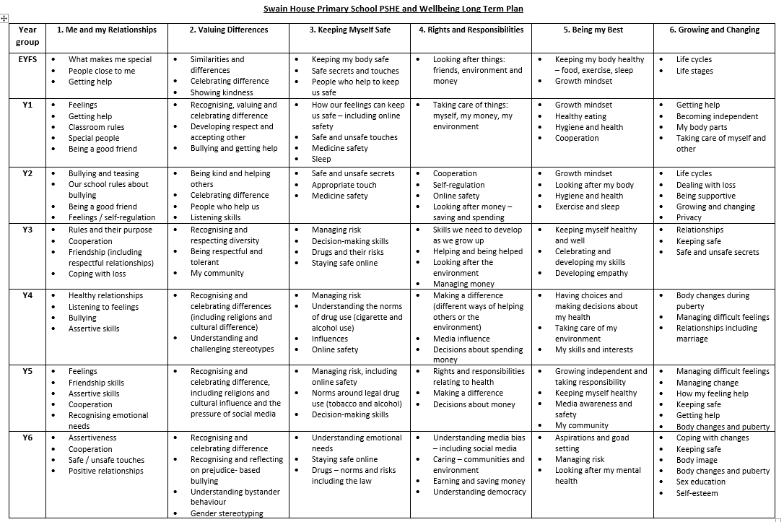

Slide 13
Why has the government made this change?
They believe relationships education will :
prevent bullying based on perceived differences
and
help children to be happy, healthy and safe and prepare them for life in a diverse modern society
Making the subject compulsory demonstrates their commitment to those aims

Slide 14
Will relationships education be suitable for my child?
Teaching will be age appropriate and respectful of faith and diversity
Relationships education does not teach children about sex

Slide 15
Will relationships education be compatible with my religion?
Schools must take into account the religious background of all pupils and handle sensitive topics appropriately
The Equality Act (2010), states that religion or belief are protected characteristics, along with: age; disability; gender reassignment; marriage and civil partnership; pregnancy and maternity; race; sex; sexual orientation.
Schools must deliver the statutory curriculum
to all pupils

Slide 16
Do the regulations apply to faith schools?
Yes, although they can also teach their faith’s perspective on relationships
In all schools, teaching should reflect the law as it applies to relationships, so that young people understand what the law allows and does not allow

Slide 17
What about children with Special Educational Needs & Disabilities?
Relationships education, like other aspects of the curriculum, should be differentiated and personalised for pupils with S.E.N.D.
Schools have a duty to prepare children for adulthood from early childhood, as set out in the S.E.N.D. code of practice
Notes:
Many parents of children with SEND are familiar with legislation and guidance such as the code of practice

Slide 18
Can I withdraw my child from relationships education?
There is no right to withdraw children from relationships education and we have to deliver the full curriculum to all children.

Slide 19
As a parent, how much say do I have about these lessons?
We are asking for your views about when and how topics will be covered
We have to teach the curriculum set by the DfE
There is no right to remove your child from relationships education lessons

Slide 20
Will my child have to learn about gay relationships/LGBT people?
We will teach children to be respectful and fair to people from all types of families, including those with a mum and dad, single parent families, adoptive and foster families, and those with same sex parents. This will be an integral part of the curriculum. There is no such thing as an “LGBT lesson”.
The DfE has included this in order to promote respect for diversity, and to prevent bullying of all children.

Slide 21
What else will my child have to learn about?
Healthy relationships with family and friends
Getting along with others in society
Bullying
Keeping themselves safe in person and online
How to get help if they feel unsafe

Slide 22
Is sex education part of these lessons?
No it isn’t. The requirement for primary schools is to teach relationships education.
This is the part parents can choose to withdraw children from. The conception part of the lesson comes in Year 6, after the puberty talk.
Notes:
Amend as appropriate. This slide applies if you are following Bradford’s model policy

Slide 23
Teaching about puberty
In Key Stage 2 children have to learn about the emotional and physical changes that happen during puberty
We will teach this in years 4, 5 and 6 and it will be delivered to single sex groups by class teachers and the charity Step2.
This was moved from Year 3 during the RSE consultation in 2021.
Year 4 - girls learn about changes to girls and boys learn about changes to boys
Year 5 - girls and boys learn about each other
Year 6 - Year 5 is repeated and learn about conception
Notes:
Amend as appropriate for your school

Slide 24
Why do we teach about puberty in primary school?
It is in children’s best interest to understand what is happening to them as they grow and it is part of the statutory health education curriculum
The average age for girls to start puberty is 11, but it can be any time between 8 and 14
Most boys start puberty between 9 and14; the average age is 12

Slide 25
Any questions?

Slide 26
Next steps
Curriculum planning will take place after this meeting, taking your feedback into account.
We will provide feedback for parents on what has changed and the draft policy will go to Governors to be approved
Relationships education consistent with our new policy will be taught from September 2023

