Slide 1
Reception Parents Meeting
2025-2026
Thursday 26th June 2025

Slide 2
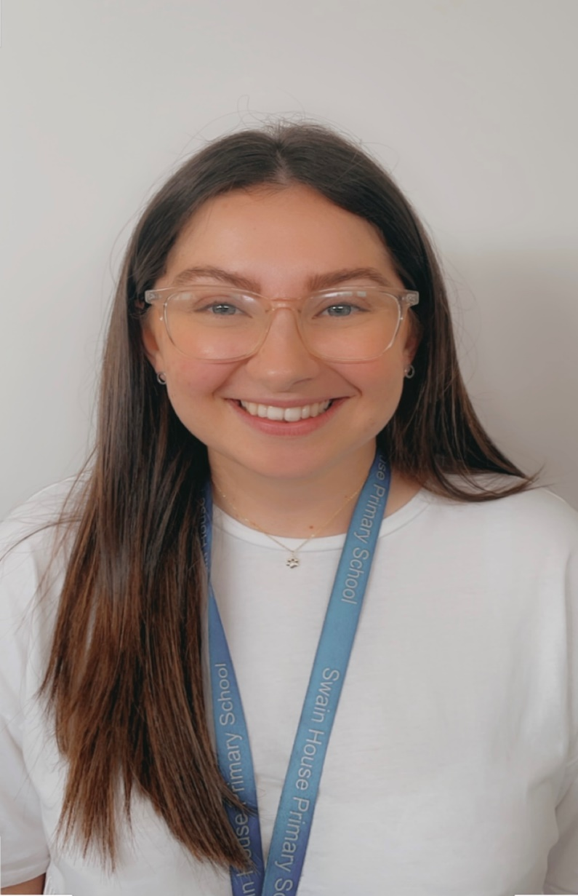
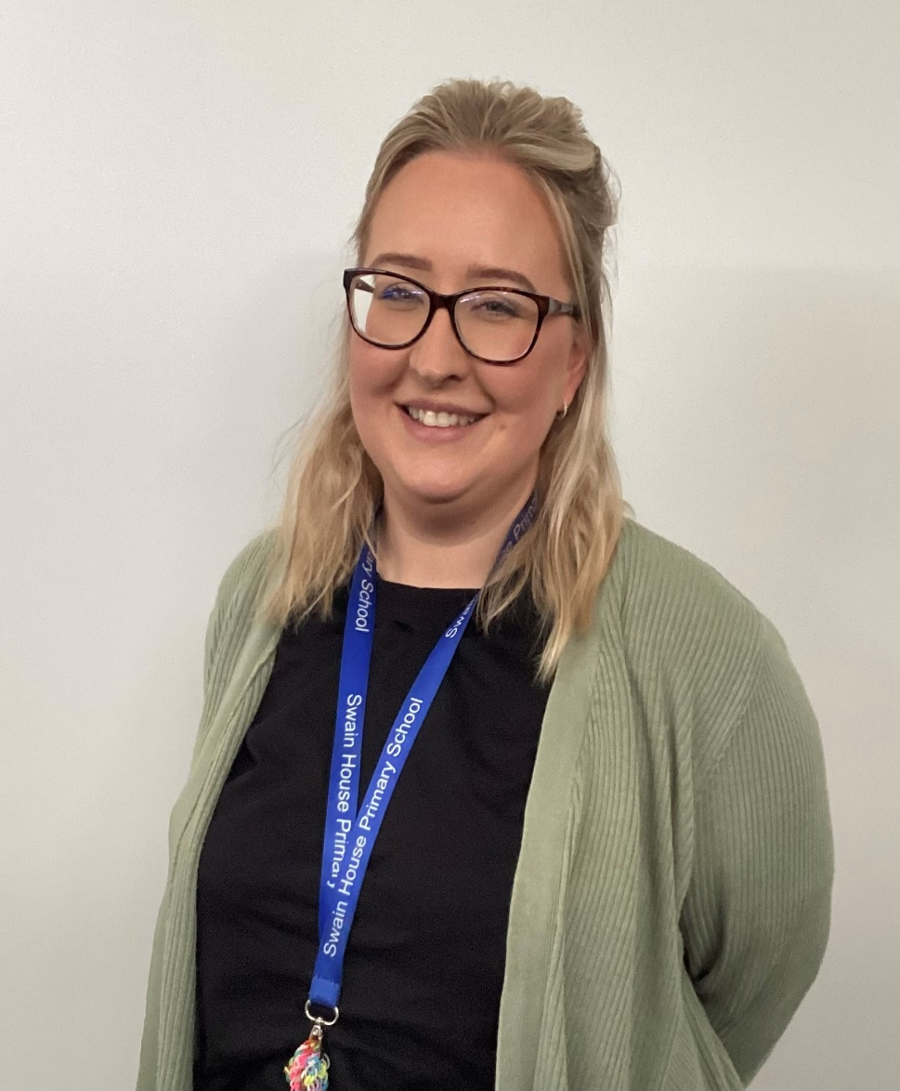
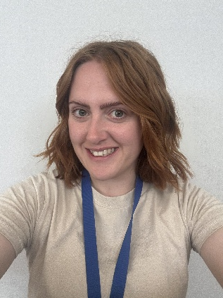
Meet the Reception Team
Mrs Laycock
Elm Class Teacher
Assistant Headteacher and Early Years Foundation Stage Leader
Miss Dearden
Willow Class Teacher
Miss Sayce
Elm Class TeachingAssistant
Willow Class Teaching Assistant
Notes:
In the process of recruiting another member of the Swain House Family to join our Reception team in September. I am sure you will join us in giving them a warm welcome to our school.

Slide 3
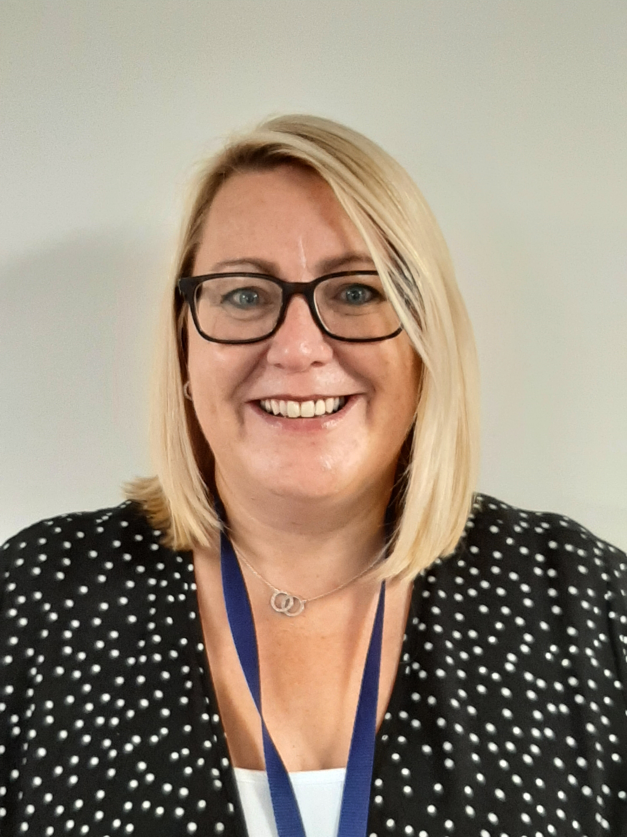
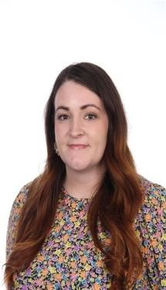
Meet the Pastoral Team
Mrs Sarah Broadbent
Learning Mentor
Miss Ellie Armitage
Learning Mentor
Notes:
Here to support you and make sure your child has everything they need to learn and thrive

Slide 4
Information Packs
You will have received an information pack on arrival today. Inside (in a brown envelope) you will find all the relevant paperwork you need to complete before your child starts school.
The name of your child's class and teacher is on the front of the information pack.
Your child’s individual transition timetable is also detailed on the front of your envelope (unless your child is having alternative transition that has already been pre-agreed).
Staggered entry into Reception Class as detailed below:
Notes:
Some children Tuesday and Some children Wednesday

Slide 5
Documents to complete and return
There will be an opportunity to complete your documents during our stay and play/coffee morning session on Monday 7th July 2025.
Admission form
GDPR form
Home School Contract
Intimate Care Consent
Local Trips Consent
EYFS Password
Tapestry Details
Sun cream Consent
Acceptable Internet Use
Attendance Information ( information for reference)
Allergy/Intolerance Form
Friends Of Swain House Sign Up Form
School Dog Permission Form
Please complete and return all forms on or before Monday 7th July.
Your child WILL NOT be able to start school until we receive ALL the required paperwork for safeguarding reasons.
Notes:
Complete EVERYTHING in your brown envelope and return it to the school office by 7th July

Slide 6
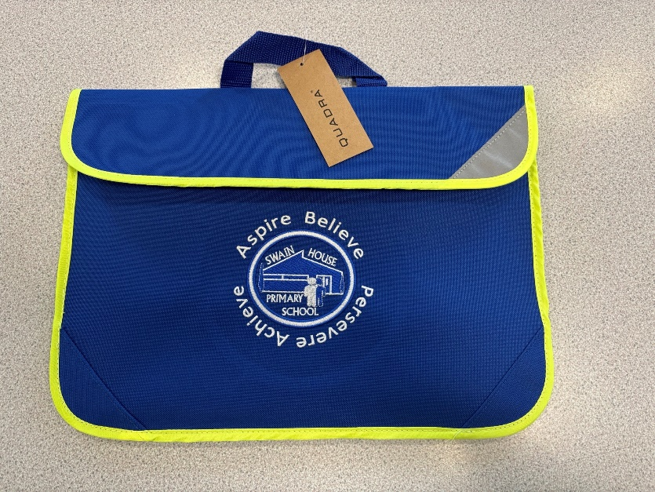
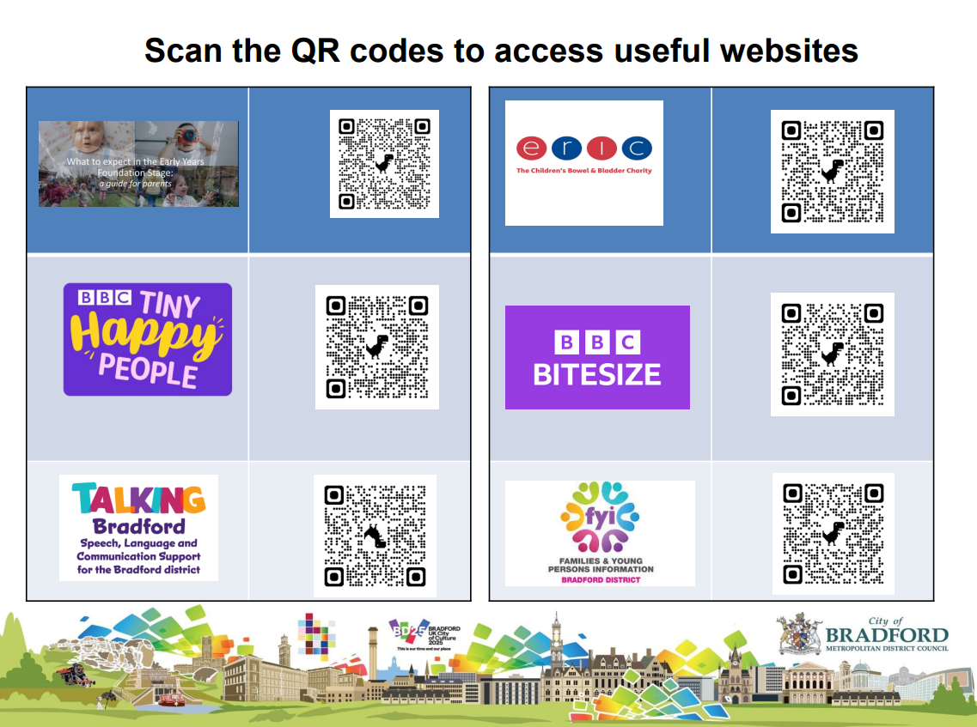
For you to keep and use…
Notes:
Useful bits we have put together for you to support a smooth transition

Slide 7
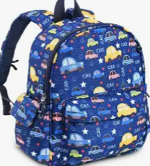
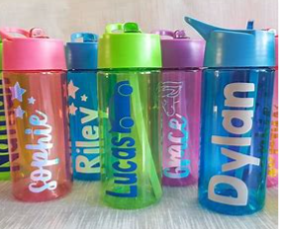
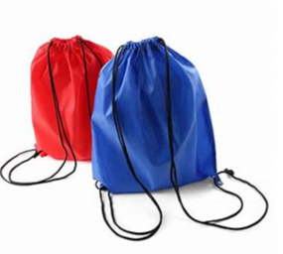
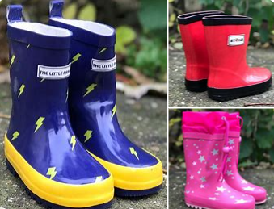
What does your child need for school?
Notes:
Spare Uniform
Underwear and Socks
Wipes and Pull Ups if required- please inform a member of the Reception team if your child is in the process of toilet training
Children MUST bring their bookbags to school everyday to support you getting important letters that are sent out as a paper copy. Most letters will be electronic.
No toys in school unless a ‘toy day’ has been confirmed

Slide 8
Getting School Ready
Growing independence:
Putting on and taking off their shoes
Using the toilet and washing their hands
Getting dressed with little help
Using cutlery
Spending time away from you
Building relationships and communicating:
Sharing and taking turns
Talking about how they are feeling and why
Singing songs and nursery rhymes
Encourage speaking clearly
Recognising their name
Listen to and follow a simple instruction
Physical development:
Walking up and down stairs
Climbing, running, jumping
Catching a large ball
Doing some puzzles and crafts
Getting outdoors as much as possible
Healthy routines
Going to bed around the same time
Limiting screen time
Encouraging trying new foods and eating a healthy diet
Brushing their teeth twice a day
Recognising when they need to clean themselves
Play, creativity and curiosity:
Taking part in imaginative play
Drawing, painting, colouring, sticking
Sharing stories
Exploring the world around them
Notes:
A message from Bradford Education Team
Increase in recent years of children not being ‘school ready’ when they join reception. A city wide message

Slide 9
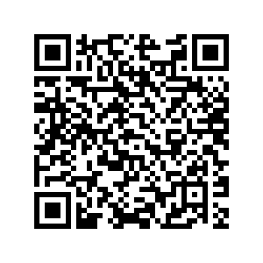
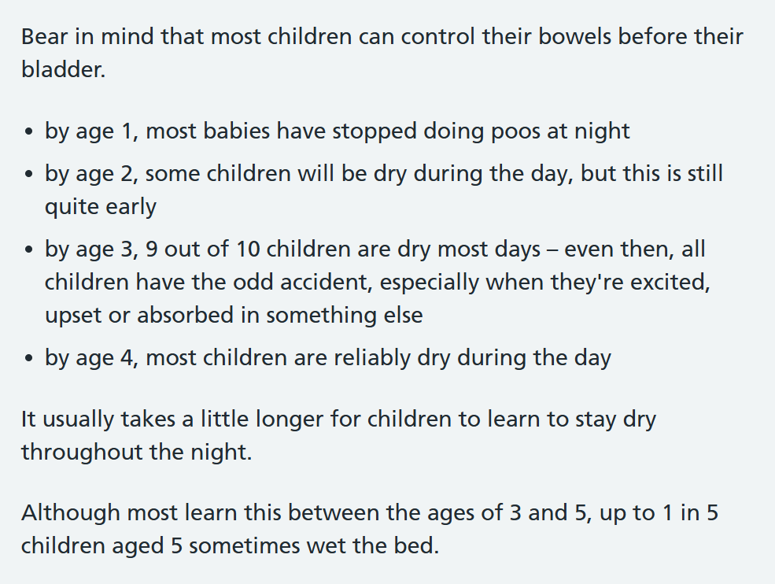
Getting School Ready
Toilet training
Swap the nappies for ‘pull ups’ as these are easier for children to pull up and down themselves and they work as a stepping stone to using the toilet.
Ask your child regularly if they need the toilet and encourage them to ‘try’ at regular intervals. Explicitly use and repeat the vocabulary you will relate to urination and bowel movements when they do them (this step might continue for some time).
When your child’s pull up is wet, encourage them to take it off, wipe their own legs and private area with a wet wipe. Children will need physical/verbal support with this initially. Take the opportunity to teach children how to wipe themselves properly after ‘using the toilet’.
Once your child’s pull up is mostly dry during the day due to them ‘trying’ on the toilet, remove their pull up and put them in underwear. Continue the ‘reminder to try’ process until your child no longer needs it. Some children may need this for some time as they become distracted.
Notes:
It is important to note that children develop at different rates and this is an ‘average’ guide
1. Pull ups don’t soak up wee as well as nappies so children will often feel that they are ‘wet’ easier in a pull up
2. You could also use a sign/symbol ( show BSL sign)
3. Teach children how to clean after having a bowel movement. Support them to wipe until ‘visibly clean’. Teach them how to hold the toilet roll/wipe.
4. Set a ‘toilet alarm’ on your phone or Alexa- child’s favourite song or a poopoo song?
5. Staff will always encourage children to develop independence in the first instance in relation to their intimate care as we view this process as a learning opportunity. Staff will then physically support the children (sometimes using hand over hand strategy) so they become familiar with the movement required to clean themselves.
This is available in a paper copy should you wish to take one for reference.

Slide 10
Notes:
Really useful websites for S&L, Toileting, Vocab, What to Expect

Slide 12
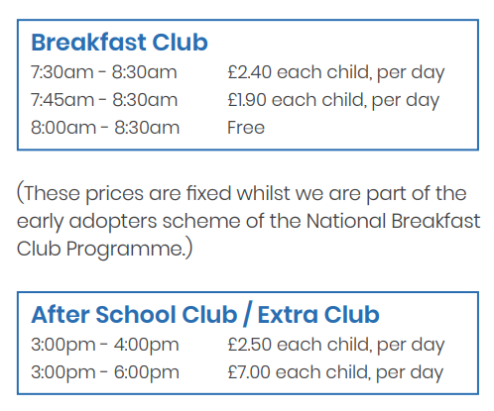
Timings of the Day
8:30am- School Starts (Registers taken at 8:40am)
3:00pm School Closes (Doors close at 3:10pm)
Notes:
PP children get free breakfast club
Reduced rate whilst part of adopter scheme- going really well ☺

Slide 13
Our Curriculum
Within EYFS, children explore and learn about the world around them through play. Staff facilitate, model and scaffold learning to support and encourage children’s natural curiosity.
CoEL- how children learn (attitude and skills)
Prime Areas- Communication and Language, Personal, Social and Emotional Development, Physical development.
Specific Areas- Literacy, Mathematics, Understanding the World, Expressive Arts and Design
Notes:
COEL- HOW children learn- can they persevere, do they have their own ideas, can they think of other ways to do things, are they proud?
Prime- Fundamental to learning and form the base of what everything else is built upon. (Focus on these over Summer)
Specific- When children are ready to learn….that’s when we focus on these!

Slide 14
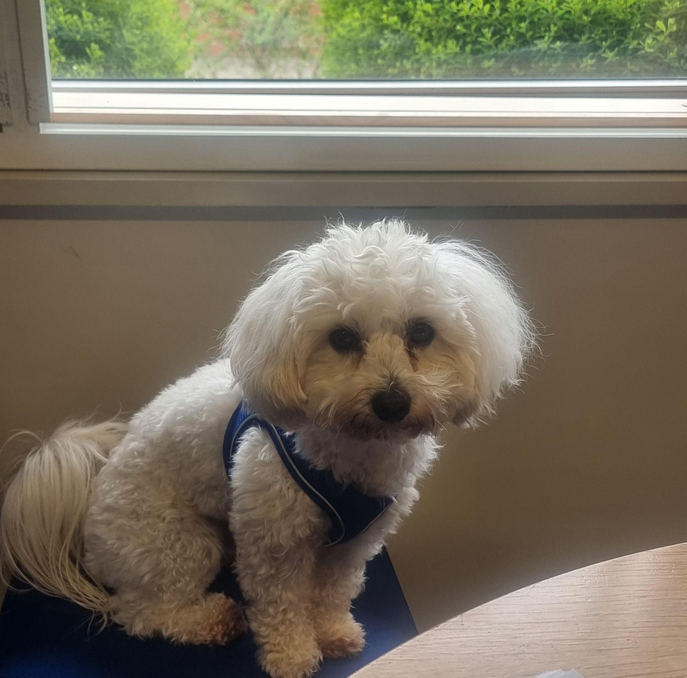
Leo
Leo is our school dog who is currently undergoing training via ‘The Dog Mentor Programme’. He is just starting out on his learning journey but has already become such a big part of our school and we are very excited about introducing Leo to the children in September and exploring the different ways that he can have a positive impact on our school community.
Notes:
Permission slip in your admissions pack- please complete and return

Slide 15
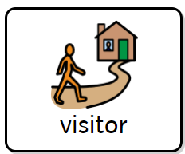
A Day in Reception
Notes:
So much more to add but ran out of room!
This will start quite basic and limited and build up over time over the course of the year to get them Y1 ready

Slide 16
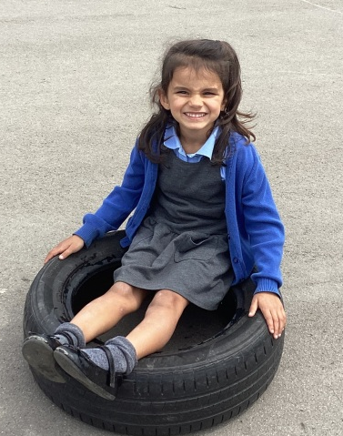
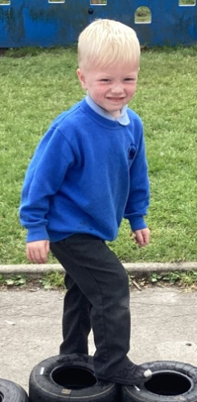
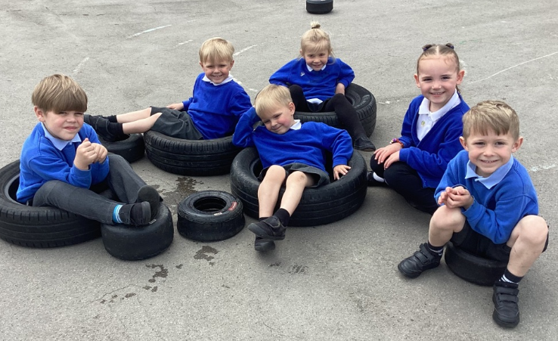
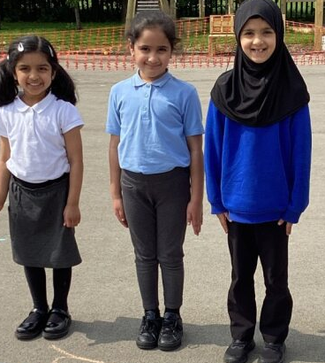
School Uniform
Main Uniform - Winter
White or light blue polo shirt or blouse/shirt
Black or grey school tailored trousers
Black or grey skirt or pinafore or salwar kameez
Royal blue sweatshirt with/without school logo
Royal blue cardigan with/without school logo
Black/grey/white plain tights
Sensible black shoes (these can be trainers but must be entirely black)
Alternative – Summer Uniform
Black or grey knee length shorts
Blue gingham summer dresses
Notes:
Slip sent home if incorrect uniform and will be recorded on PM sheets
Available on website if you need to refer to it

Slide 17
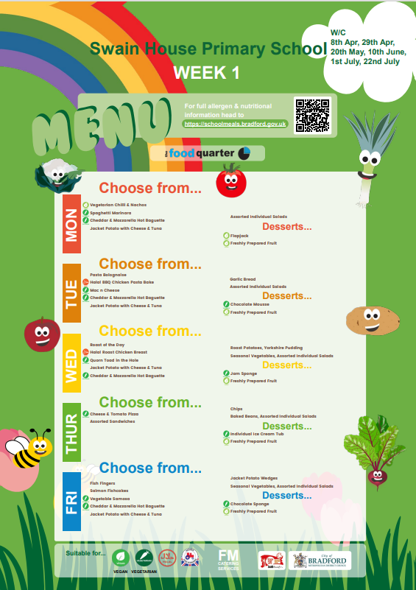
Lunchtime
School dinners are free for all Reception children.
Packed Lunches must be healthy and contain a ‘main meal’
e.g. sandwich, wrap, salad, roll, pasta.
Snacks
Milk is available in the classroom at group snack time and is free for your child until they reach the age of 5.
The term after their 5th birthday, milk costs £10 per term.
Children receive a free piece of fruit or vegetable every day.
Children have access to their water bottle all day within the classroom
(no fruit juice or fizzy drinks)
Notes:
Recommend you trial the 3 week lunch cycle to see what they like. Lots of support in dinner hall and children can see and choose their own food
Halal or vegetarian options available daily
Packed lunch – must be healthy and cut up grapes (consider choking hazards)

Slide 18
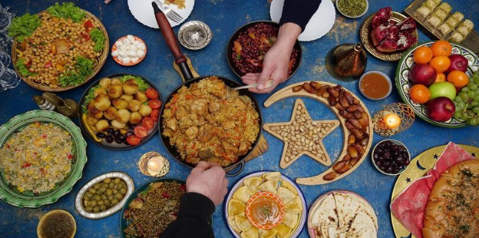
Enhancement Fund
This is to provide the children with a range of in class experiences throughout the year such as food tasting for festivals or seasons.
£3.50 per half term or £20 for the year
(Hand in to a member of the Reception team in a named envelope)
Notes:
Eid, Baking, Growing food/herbs
Can pay now over on the table and we can tick you off the list for the year so you don’t need to worry!

Slide 19
Reading and Homework
Reading
Initially , your child will have a 1:1 reading session each week with a member of the Reception team until they become more confident in sound recognition and word blending. They will then engage in group guided reading. Children need to bring their book bag every day to support their reading development and to keep safe any letters or achievements.
Homework
Reading at home 3x a week (using their home reading book)
Learning high frequency words and tricky words
Activities linked to our learning in class where appropriate (Sent via Tapestry)
Sharing their experiences via Tapestry for show and tell
Notes:
Must bring bookbags to record reading
More info to follow when reading records are sent out Autumn 2

Slide 20
Positive Behaviour Policy
We have only three clear rules for children to follow.
Rule 1 – Always follow instructions from a known adult in school.
Rule 2 – Keep your body and objects to yourself.
Rule 3 – Speak politely to others.
Notes:
We spend a long time in Autumn term discussing these and using them as a learning opportunity.
Calm area to support regulation ( zones and MHM) using relaxing space and resources to support

Slide 21
Rewards
Stickers/prize box – for individual achievements
Class rewards – for working as a team
Blue thumbs up – good behaviour
Recognition board – good behaviour/good learning
Red stars – good learning
Extra play time – attendance/punctuality rewards
Notes:
Positive praise based approach- lots of rewards

Slide 22
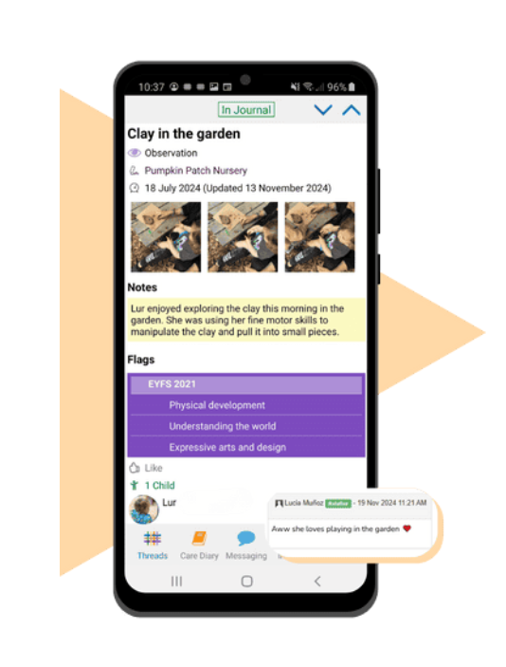
Home/School Communication
Tapestry- An online platform to share children's learning and achievements and communicate with your child’s class teacher.
Notes:
Learning and Acheivements shared from school
Photos shared from home (show and tell)
Login sent via email when added to the system ready for first day
Download app in preparation

Slide 23
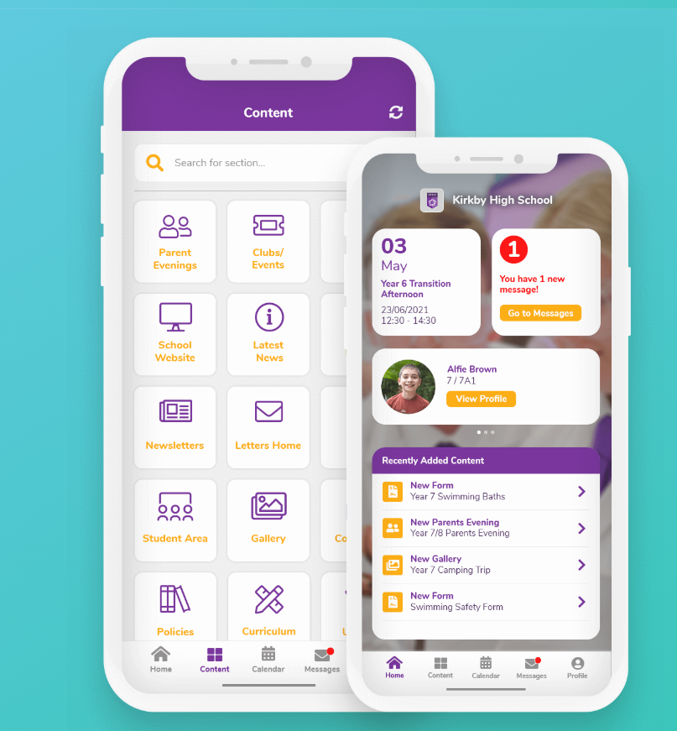
Home/School Communication
Parentsapp- A whole school communication system to share letters, upcoming events and important dates.
Notes:
Download app

Slide 24
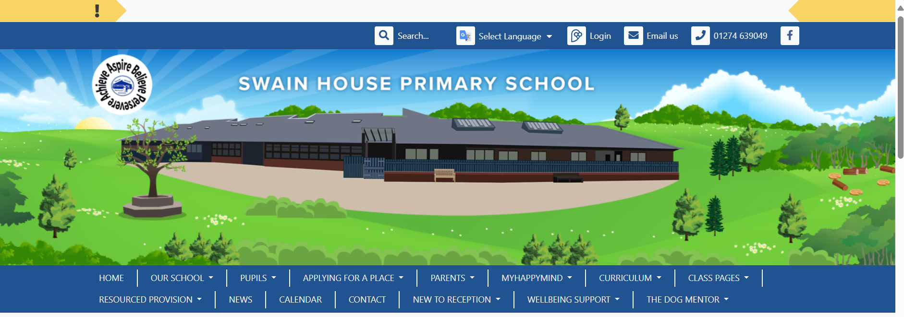
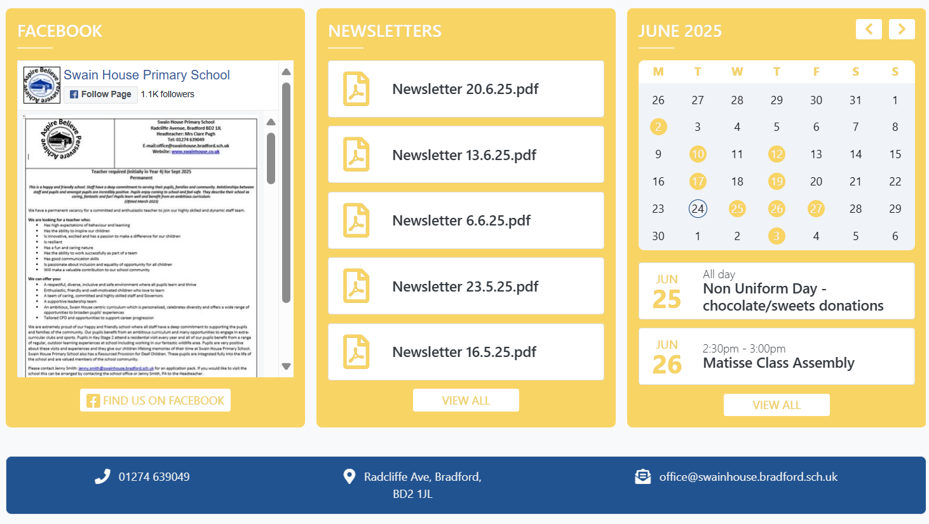
Home/School Communication
School Website- share information and documents with parents.
Notes:
Check website and familiarise yourself with the zones

Slide 25
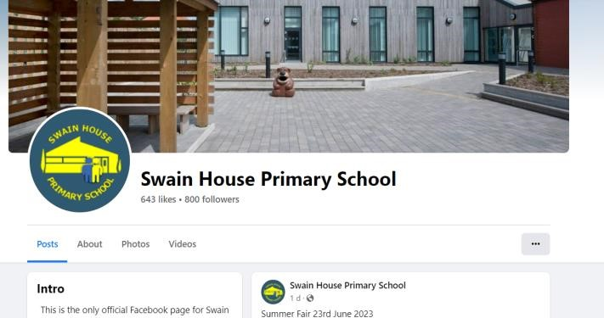
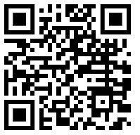
Facebook- a platform to share learning across school and upcoming events and dates.
Scan the QR code to follow us on Facebook
Notes:
Share pictures and events- please join
Parent’s Group- set up by parents to share messages/ remind each other- must be used appropriately and in line with the parent code of conduct
If there is a problem, please do not share your frustrations on social media as that will not solve the problem, please speak to a member of staff- we are always happy to help

Slide 26
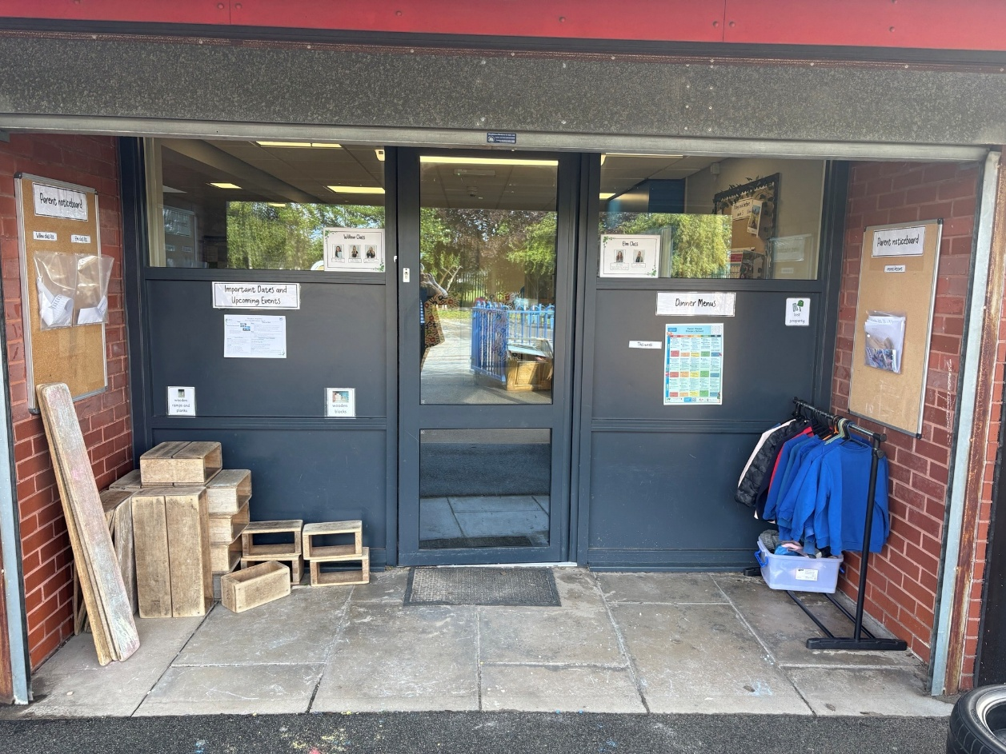
Parent Area- An area just outside Reception drop off area with copies of recent letters, the dinner menu, upcoming events, latest curriculum letter, class lists (for parties etc) and lost property.
Notes:
Chat to a member of the team at drop off/pick up (brief conversation)
Arrange a phone call/meeting with the teacher (longer conversation)
Transition check in End September 2025
Parents evening 3x a Year (October 2025, January 2026, April 2026)
End of Year written report (July 2026)
Report drop in ( July 2026)

Slide 27
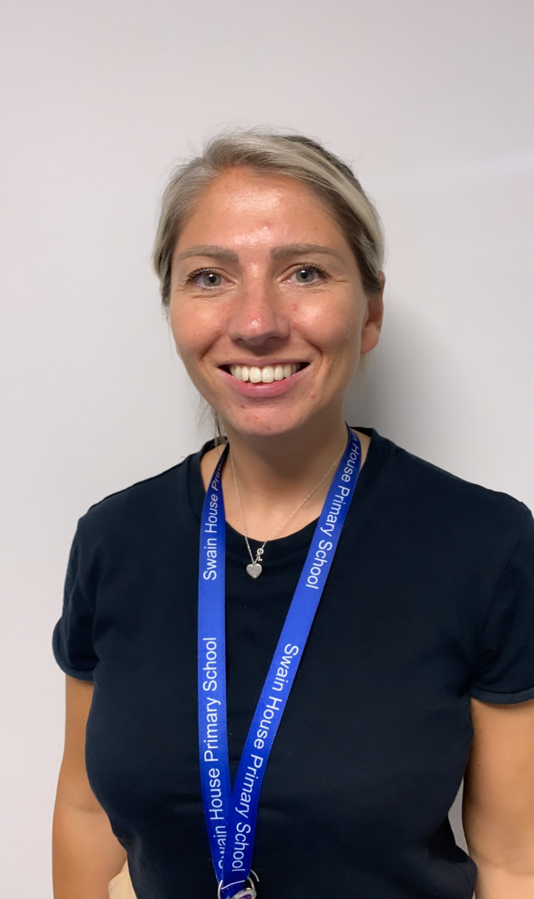
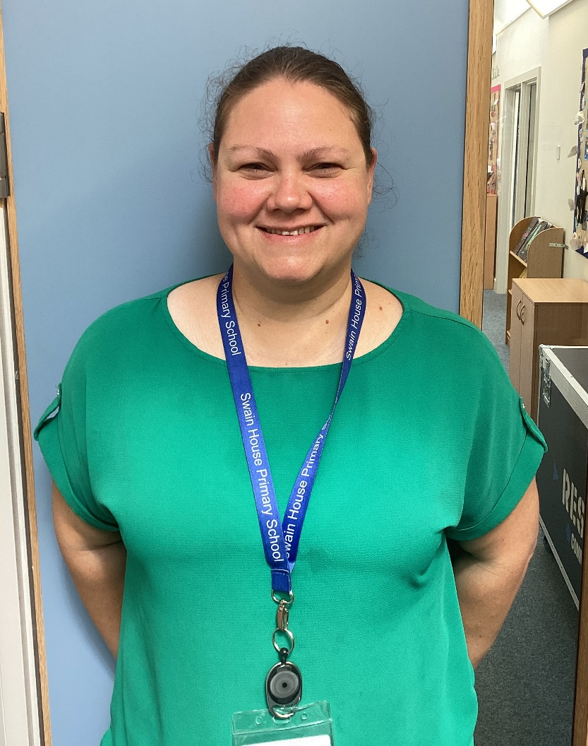
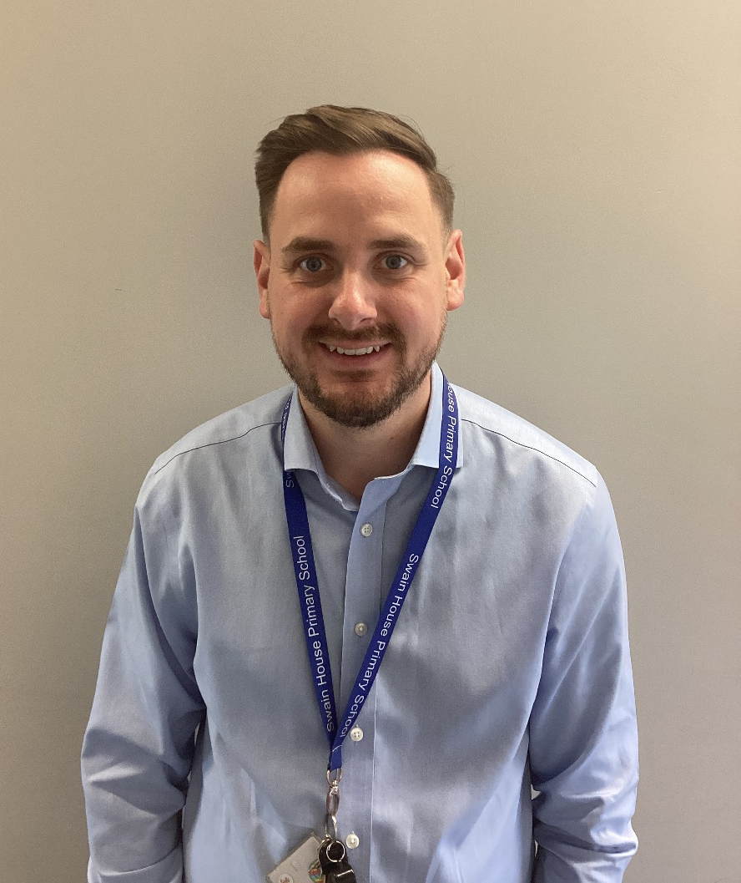
Meet the SEND team
Mrs Kylie White
Assistant Headteacher and SENDco
(currently on maternity leave)
Miss Claire Broomfield
Deputy Headteacher and Acting SENDco
Mr Andrew George
Assistant SENDco
Notes:
KW- maternity leave will be back later in the year

Slide 28
SEND
How are pupils with SEND identified?
Initial concerns about a child’s progress or development may come from:
The class teacher
- The school’s rigorous assessment cycle
A health professional such as a GP or Health Visitor
- Previous educational settings such as previous schools, nurseries or Children’s Centres.
Parents approaching school with their concerns
The child
send@swainhouse.bradford.sch.uk
During the second term the Reception teacher and the SENDCo will discuss any concerns about the progress of identified children, and set targets and success criteria accordingly. These concerns will be recorded on and parents/carers will be informed.

Slide 29
Medical Conditions
If your child has any medical conditions, additional medical needs, or allergies, please ensure school are aware via your
admissions forms.
Please be very clear and specific with your information, provide official documentation from the GP and ensure we have any necessary medication
in school.
Asthma/Inhalers – Please advise school (via your admission form) if your child has been diagnosed with asthma or uses an inhaler. School must have
a completed Asthma card ( provided by school) and an inhaler that will
stay in school.

Slide 30
Dietary Needs
If your child has any special dietary requirements or food allergies, please ensure school are aware (via your admission form).
Please be very clear with your information (intolerance or allergy) and ensure we have any necessary equipment/medication required to manage your child’s allergy.
Please DO NOT include ‘dislikes to food’ in the allergy sections.

Slide 31
Attendance
Attending school every day is key to your child’s progress and development.
There are two types of absence – authorised and unauthorised
(both types of absence will deduct from your child’s attendance percentage)
Authorised Absences
These are absences that cannot be avoided and are important for medical, religious or wellbeing reasons e.g.
Genuine illness of the pupil (where possible provide evidence)
Medical appointment for the pupil (not routine dentist/doctors appointments)
Death of a near relative
Religious observance – 3 days per year
Unauthorised Absences
These are absences that could be avoided with effective time management and organisation.
A shopping trip, a birthday treat, oversleeping due to a late night, looking after other children,
letting the gas man in or the parent or carer is unwell.
Please always contact school if your child is well enough to come to school but you can’t get them here,
we will always help when we can!

Slide 32
Punctuality
The school day starts at 8.30am, the classroom doors are open until 8.40am.
If your child arrives to school after 8.40am, they are late.
When a child arrives late to school it can be very disruptive to your child, the teacher and
other children in the class.
If your child arrives late to school they will be marked as late on the register as an “L” code.
The time they get into school and the reason for lateness is also noted on the register, this is done
by the attendance team.
If a child is late 3 times in a half-term, a member of the Attendance Team will contact you to discuss this and find out if there are any ways school can offer any support to improve punctuality.
If your child is late again after this discussion, the attendance will pass your details to our Attendance Officer from the Education Safeguarding Team, who again will offer support and strategies to improve punctuality.
All registers close at 9am, if your child arrives after 9am, they will receive a “U” code, however the time and reason for lateness are still noted on the register.

Slide 33
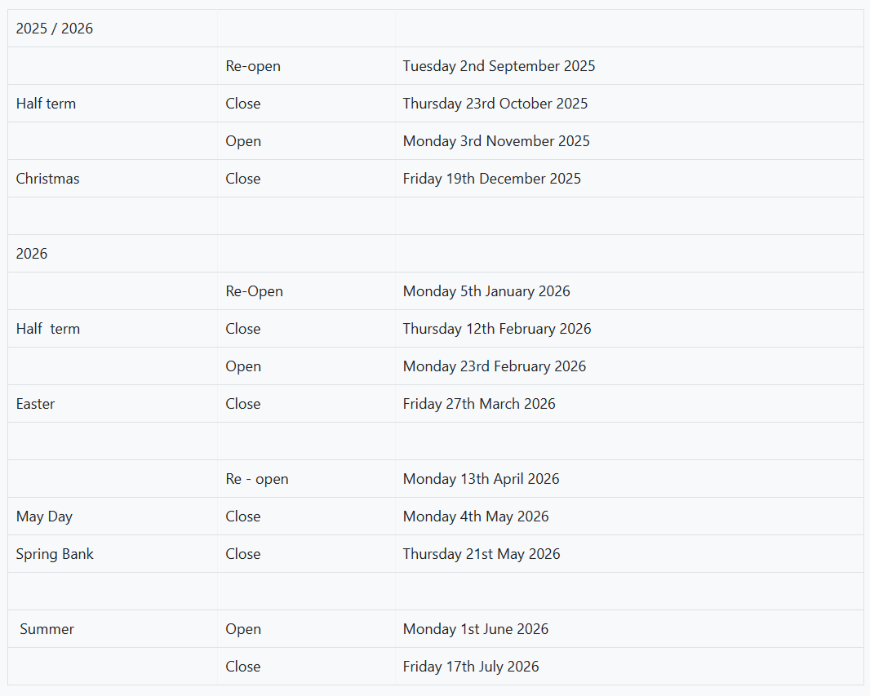
School Holiday Dates
Notes:
Available on the website

Slide 34
Transition Stay and Play Session
Monday 7th July- 9:15am -11:15am
Your child is invited to explore their new learning environment, meet the Reception staff team and meet the other children in their class and cohort.
During this time, you are invited to a coffee morning to meet other parents and complete any remaining forms/documents.
Please be mindful that this is the only time your child will have the chance to meet the other members of their new class before the term starts in September so we strongly encourage their attendance.
This is also the deadline for the admissions paperwork to be in so we can get all childrens data imputed onto the system before their start date.
.
Notes:
IMPORTANT- CAN NOT STRESS ENOUGH HOW MUCH THIS WILL SUPPORT YOUR CHILDREN TO SETTLE
PAPERWORK MUST BE DONE BY THIS DATE OR YOU CAN DO IT ON THE DAY WHILST HAVING A BREW☺

Slide 35
A Gift From Swain House Primary
Inside your book bag is a copy of ‘Let’s Get Ready for School’ by Jane Porter.
We have chosen to give every child a copy of this book, to help them think about the process of starting a new school. We will refer to this book when the children start school in September. Please share it with your child over the Summer!
.

Slide 36
Any Questions?
We hope you enjoyed looking around our school and we look forward to working in partnership with you over the coming years.
Thank you for attending the meeting!
Notes:
This PPT will be available on the school website for you to refer back to should you wish to do so.

