Slide 1


Reception Phonics Meeting
Swain House Primary School
30.09.2025

Slide 2
Agenda
What is Phonics?
Why Rocket Phonics?
How will my child be taught phonics?
What will my child read?
Reading
How can I support my child at home?
Questions

Slide 3
What is Phonics?

Slide 4
What is Phonics?
Systematic Synthetic Phonics is a way of teaching children to read, write and spell. The sounds that children learn are taught in a specific, systematic order (not alphabetically) so that children can begin to build words from these sounds as early as possible.
Phonics supports children to hear, identify and link the sounds that letters make (phonemes) to what the letters look like when written down (graphemes). This helps children to recognise and read words, using knowledge of the sounds to read new or unfamiliar words.
Phonics is a cornerstone to education here at Swain House Primary School and is a lifelong skill that our children will use.

Slide 5
What is Phonics?
Here are some terms that your children will become familiar with:
Phoneme - the sound
Grapheme – how the sound is written
Digraph – Two letters which together represent one sound, e.g. ai, ee, oo.
Trigraph- Three letters which together represent one sound, e.g. igh, air, ear.
Blending – reading the individual sounds together to make a word
Segmenting – listening to a word and breaking it up into the letter sounds

Slide 6
Why Rocket Phonics?

Slide 7

Why Rocket Phonics?
https://www.youtube.com/watch?reload=9&v=sf_9Fo69wVI

Slide 8


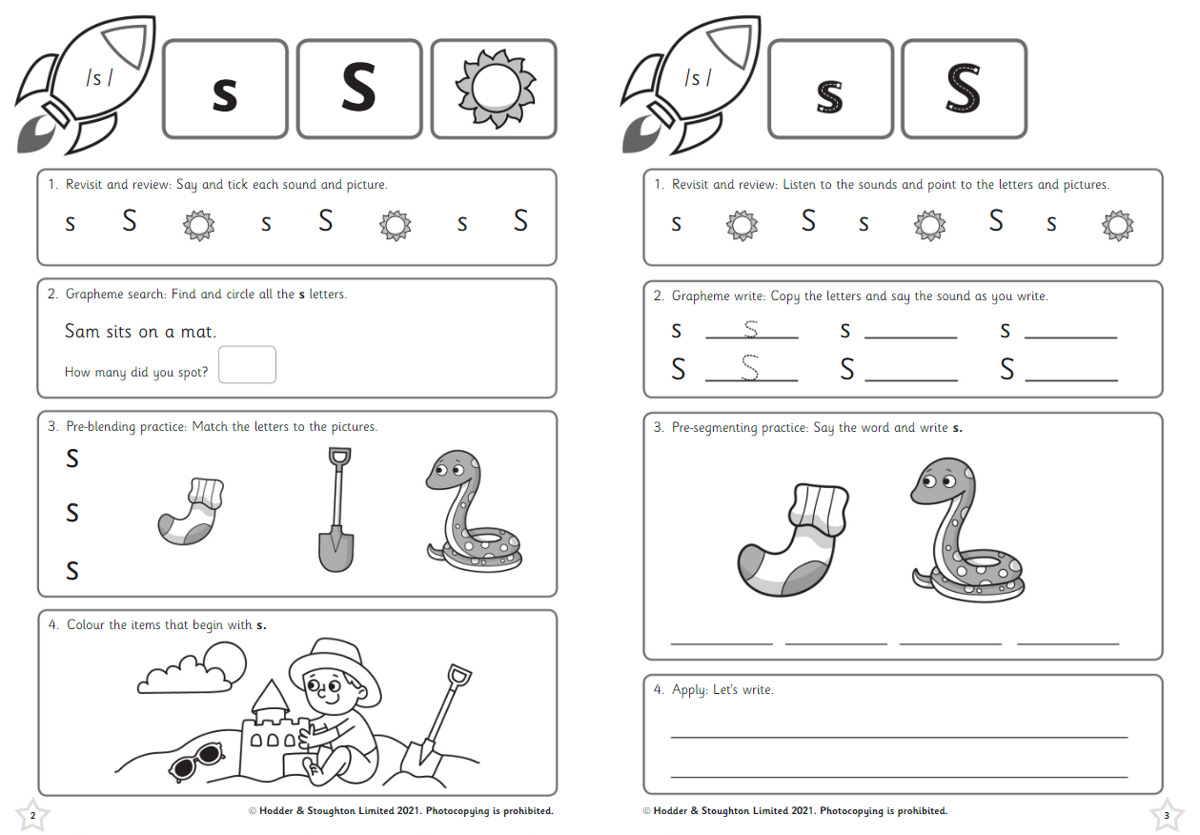
Why Rocket Phonics?
There are lots of engaging resources such as flashcards, sound mats, and online, interactive Big Books and quizzes to develop learning further.
There is a fully matched series of decodable reading books from a variety of genres.
The clear plans and lesson structure will also ensure teaching from Reception to KS1 is consistent, and the children will already know the routine when they move to KS1.

Slide 9
How will my child be taught Phonics?

Slide 10
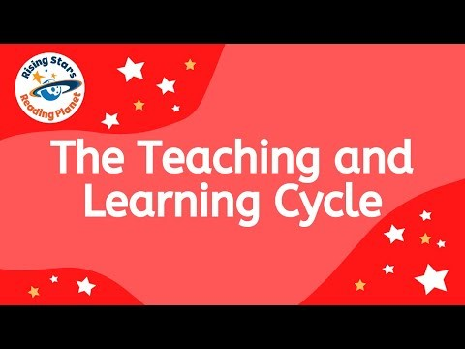
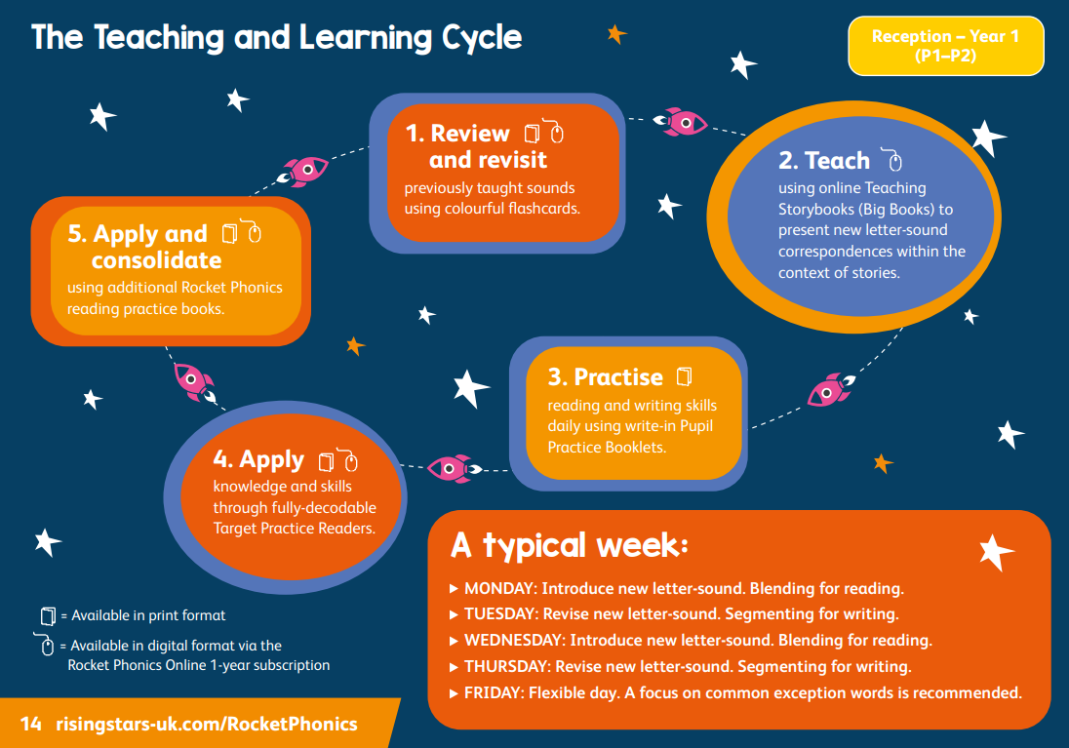
How will my child be taught Phonics?
https://www.youtube.com/watch?v=Waawaevco6E&list=PLkCyTyvoxZzuVAMhhujteytc2nVCPm6nX&index=26

Slide 11
How will my child be taught Phonics?

Slide 12
How will my child be taught Phonics?
Day 1 – Blending
Read the page of the Big Book and explore the vocabulary
Day 1 – Blending
Revisit and Review
Day 1 – Blending
Introduce the new sound, modelling the correct pronunciation

Slide 13
How will my child be taught Phonics?
Day 2
Day 2 – Segmenting
Recap taught sound and orally segment words involving taught sounds
Day 2 – Segmenting
Quickfire grapheme recall. Children air write or use mini whiteboards
Day 2 – Segmenting
Model how to form the letter and segment using dashes

Slide 14
What will my child read?

Slide 15

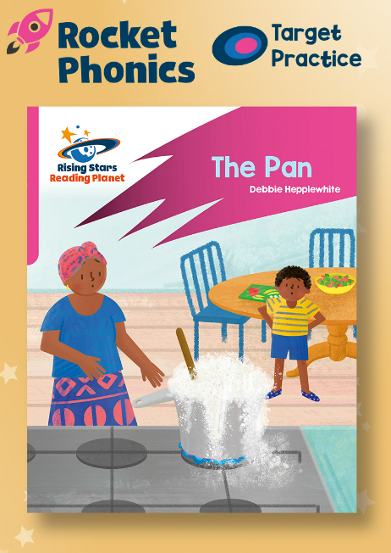

What will my child read?
Big Books – These are the books used in the Phonics sessions, exploring two pages every two days in detail around the sound being taught.
Target Practice Readers – These can be read independently as an extension, 1:1, in pairs or in small guided reading groups. These focus on smaller groups of sounds matched to your child’s phonetic knowledge.
Rocket Phonics Readers – These are the reading books your child will bring home at an appropriate level and will contain sounds your child has already learnt and is learning. These books can also be accessed online.

Slide 16
Reading

Slide 17
Reading
Whilst in Reception, your child will take part in weekly 1:1 reading sessions with a member of staff where they will read books matched to their phonetic knowledge.
Once your child has developed a number of the skills associated with reading, they will then move towards reading in groups (guided reading).
They will read books that are linked appropriately to the sounds that they have learnt and are learning.

Slide 18
Reading
Later in the year, your child will take part in three guided reading sessions a week:
          Session 1 – Decode Read
          -Children will use their phonetic knowledge to blend the sounds in the words to read the words.
          Session 2 – Prosody
          -Children will focus on the flow of their reading re-reading the words to read the sentence fluidly. They will also focus on expression and using a ‘storyteller voice’.
          Session 3 – Comprehension
          -Children will focus on understanding what they have read by asking/answering questions about the text.

Slide 19
How can I support my child at home?

Slide 20
Reading at home
We expect you to share the home reading book with your child at least 3 times a week as their homework and record this in their reading record diary.
Children will bring home Lilac banded book to begin with (no words) where you can focus on describing pictures, predicting, new vocabulary and using their imagination.
During parent consultation evenings, your child’s progress will be discussed and pupil mentoring sheets will be shared with you. Reading at home is an area that is tracked throughout school due to the importance we place on learning this skill.

Slide 21
How to support phonics at home…
Play games that supports listening e.g. Simon says, what’s that sound, hide and seek (say their name).
Segment and blend words in everyday life e.g. can you get your c-oa-t on.
Treasure hunt. Hide sounds around house or find things beginning with…
Share new vocabulary- explore the meaning and comment on the sounds in the words.
Play games to support gross/fine motor skills for writing. E.g. using pegs to peg the washing, using a knife and fork to eat food, opening packets.
Play ‘copy me’ games to encourage children to make different sounds with their mouths/voices and focus on mouth movements..
Spot graphemes in the environment. E.g. I can see a ….. on that sign over there.
Read lots of books to promote a love of reading. Bedtime stories are a great way to do this!
Model writing for a purpose with children e.g. shopping list, birthday cards etc. and talk aloud when you are writing.
Play games that support hearing specific sounds e.g. initial sounds such as I spy ( always use pure sounds).
Give children opportunities to draw and write. Play games e.g. you write the word and they draw the picture

Slide 22
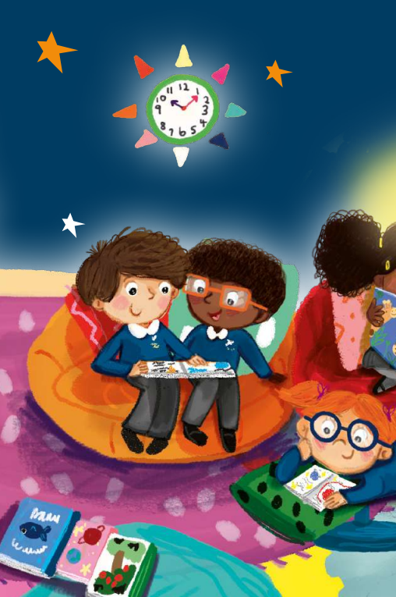
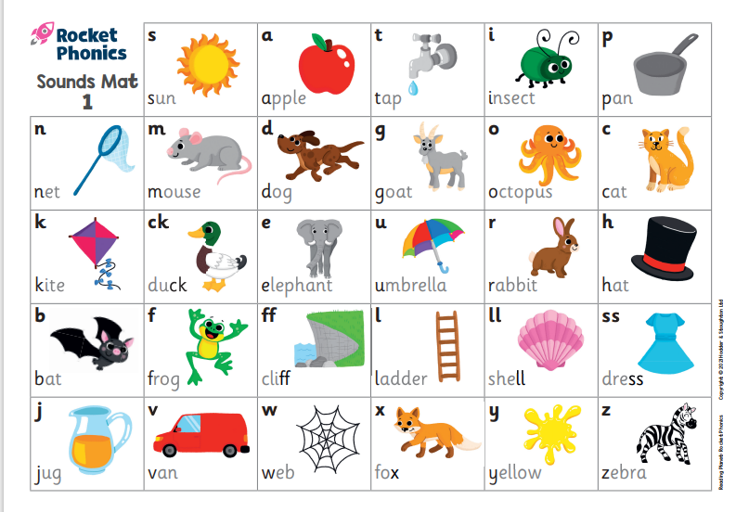
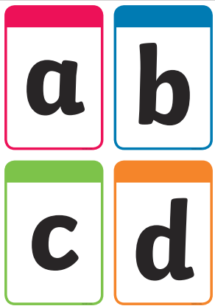

In your pack….
QR codes for:
Sound pronunciation
Teaching blending
Teaching segmenting

Slide 23
Thank you all for coming.
Any Questions?

Slide 24
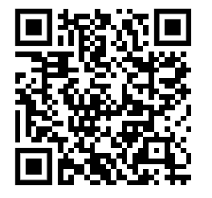
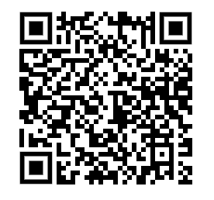
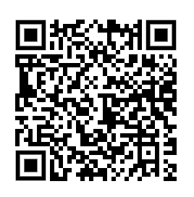
QR Codes
for sound pronunciation (pure sounds)
Video | QR Code
Correct pronunciation of sounds (pure sounds)
Teaching sequence (blending)
Teaching sequence (segmenting)

