Slide 1

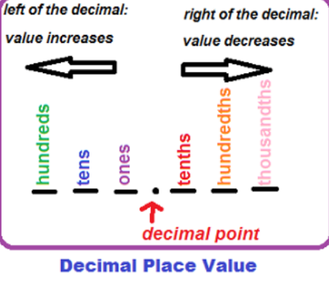
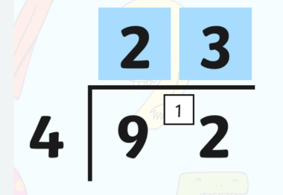


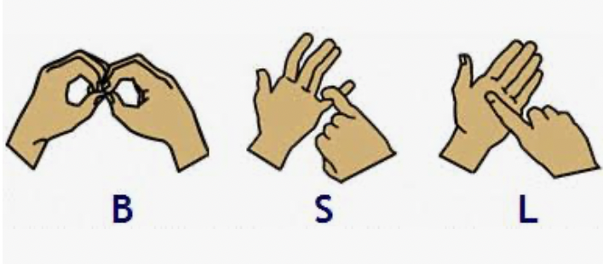
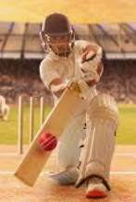
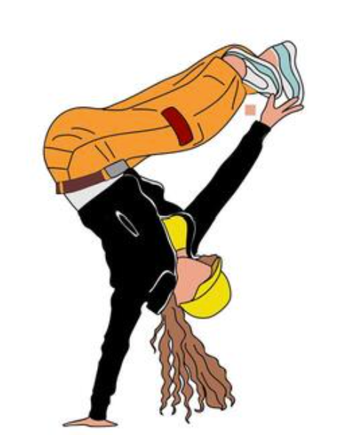

Swain House Resourced Provision
Summer 2
Our focus book this half term is:
Maths
As mathematicians
we will learn about:
Yr 2 /3 Statistics, and fractions.
Yr 5 /6 Decimal and fraction equivalents, symmetry in shapes, rounding and division/remainders.
In English
We will be reading the fiction story,
The Snail and the Whale by Julia Donaldson.
We will develop our sentence writing through descriptive writing, captions, character thoughts, postcards, predictions and opinion work, while exploring themes of adventure, friendship, teamwork and caring for the world around us.
In BSL, we will learn about:
Deaf ROLE MODELS and DEAF SPORTS
Helen Keller Class | Paul Whittaker class
Scientists Sound
Scientists Properties of Materials
PE Year 4 – Street Dance Year 5/6 - Cricket
PE – Street Dance ?
PSHE + RSE Being My Best, Puberty and Positive Masculinity.
PSHE Changing and Growing and hygiene
RP Sports Day at Hanson school
24th June 2026

