Slide 1
Reception Phonics Meeting
Swain House Primary School

Slide 2
Agenda
What is Phonics?
Why Rocket Phonics?
How will my child be taught phonics?
What will my child read?
Reading
Questions

Slide 3
What is Phonics?

Slide 4
What is Phonics?
Systematic Synthetic Phonics is a way of teaching children to read, write and spell. The sounds that children learn are taught in a specific, systematic order (not alphabetically) so that children can begin to build words from these sounds as early as possible.
Phonics supports children to hear, identify and link the sounds that letters make (phonemes) to what the letters look like when written down (graphemes). This helps children to recognise and read words, using knowledge of the sounds to read new or unfamiliar words.
Phonics is a cornerstone to education here at Swain House Primary School and is a lifelong skill that our children will use.

Slide 5
What is Phonics?
Here are some terms that your children will become familiar with:
Phoneme - the sound
Grapheme – how the sound is written
Digraph – Two letters which together represent one sound, e.g. ai, ea, mb
Blending – reading the individual sounds together to make a word
Segmenting – listening to a word and breaking it up into the letter sounds

Slide 6
Why Rocket Phonics?

Slide 7
Why Rocket Phonics?
Click the Link if the video doesn’t load.
https://www.youtube.com/watch?reload=9&v=sf_9Fo69wVI

Slide 8
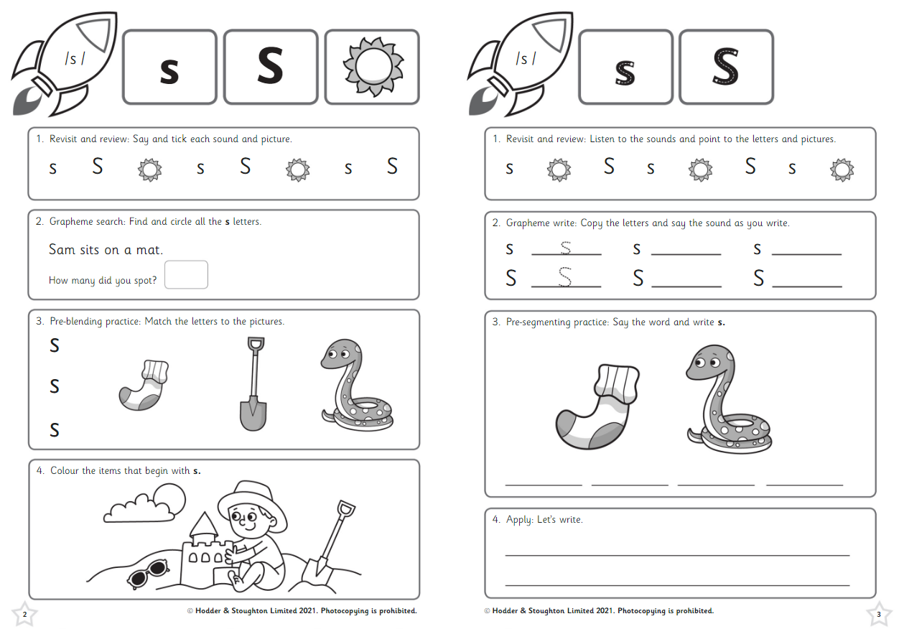
Why Rocket Phonics?
There are lots of engaging resources such as flashcards, sound mats, and online, interactive Big Books and quizzes to develop learning further.
There is a fully matched series of decodable reading books from a variety of genres.
Books are available online and quizzes help the children to develop their reading comprehension skills.
The reading books are varied, diverse and interesting.
The clear plans and lesson structure will also ensure teaching from Reception to KS1 is consistent, and the children will already know the routine when they move to KS1.

Slide 9
How will my child be taught Phonics?

Slide 10
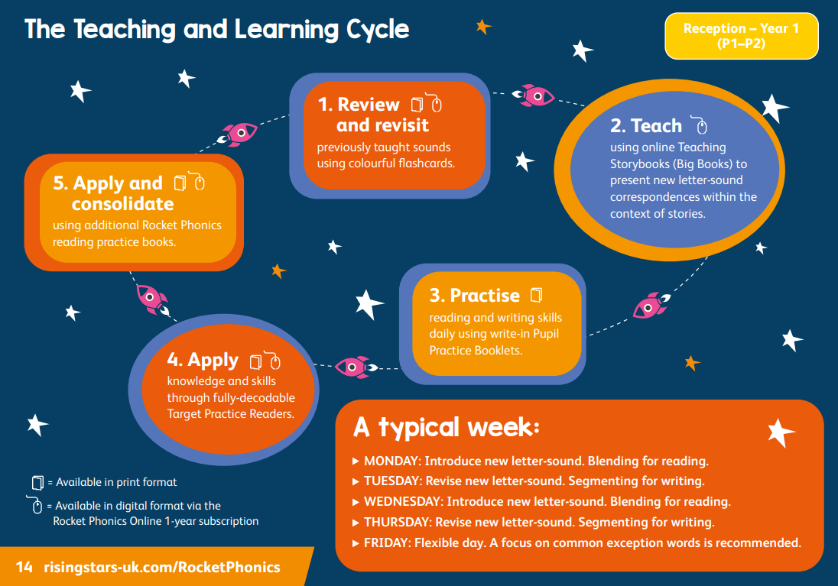
How will my child be taught Phonics?
Click the Link if the video doesn’t load.
https://www.youtube.com/watch?v=Waawaevco6E&list=PLkCyTyvoxZzuVAMhhujteytc2nVCPm6nX&index=26

Slide 11
How will my child be taught Phonics?

Slide 12
How will my child be taught Phonics?
Day 1
Day 1 – Blending
Revisit and Review
Day 1 – Blending
Introduce the new sound, modelling the correct pronunciation
https://www.youtube.com/watch?v=PlWK6Q9_cXQ&list=PLkCyTyvoxZzuVAMhhujteytc2nVCPm6nX&index=3
Day 1 – Blending
Read the page of the Big Book and explore the vocabulary

Slide 13
How will my child be taught Phonics?
Day 1
Day 1 – Blending
Children complete the Pupil Practice Booklet
https://www.youtube.com/watch?v=vODmJws1EYM&list=PLkCyTyvoxZzuVAMhhujteytc2nVCPm6nX&index=4

Slide 14
How will my child be taught Phonics?
Day 2
Day 2 – Segmenting
Recap taught sound and orally segment words involving taught sounds
Day 2 – Segmenting
Quickfire grapheme recall. Children air write or use mini whiteboards
https://www.youtube.com/watch?v=ec9iNrXSdJE&list=PLkCyTyvoxZzuVAMhhujteytc2nVCPm6nX&index=5
Day 2 – Segmenting
Model how to form the letter and segment using dashes

Slide 15
How will my child be taught Phonics?
Day 2
Day 2 – Segmenting
Children complete the Pupil Practice Booklet
https://www.youtube.com/watch?v=bdE5kb1QdiM&list=PLkCyTyvoxZzuVAMhhujteytc2nVCPm6nX&index=6

Slide 16
What will my child read?

Slide 17
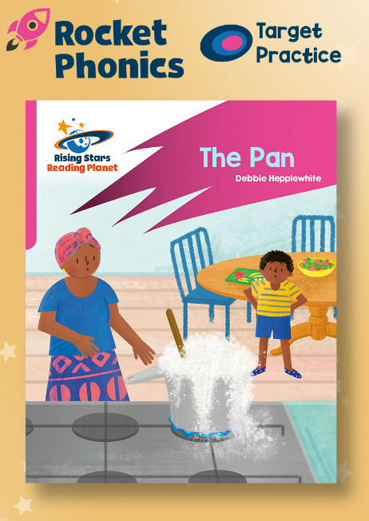
What will my child read?
Big Books – These are the books used in the Phonics sessions, exploring two pages every two days in detail around the sound being taught.
Target Practice Readers – These can be read independently as an extension, 1:1, in pairs or in small guided reading groups. These focus on smaller groups of sounds.
Rocket Phonics Readers – These are the reading books your child will bring home at an appropriate level and will contain sounds your child has already learnt and is learning. These books can also be accessed online.

Slide 18
Reading

Slide 19
Reading
Whilst in Reception, your child will take part in three guided reading sessions a week:
Session 1 – Decode Read
Session 2 – Prosody
Session 3 - Comprehension
They will read books that are linked appropriately to the sounds that they have learnt and are learning.
Please work with us and read with your child as much as possible – every little helps!

Slide 20
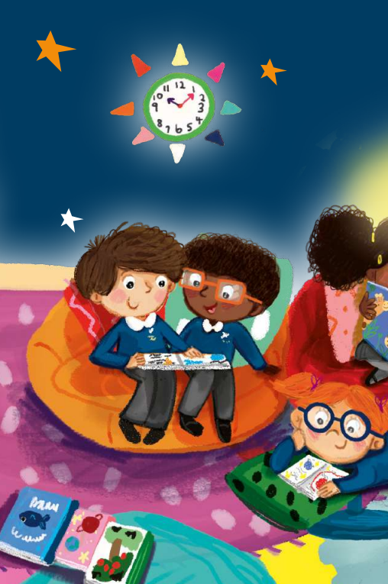
Thank you all for coming.
Any Questions?

