Slide 1
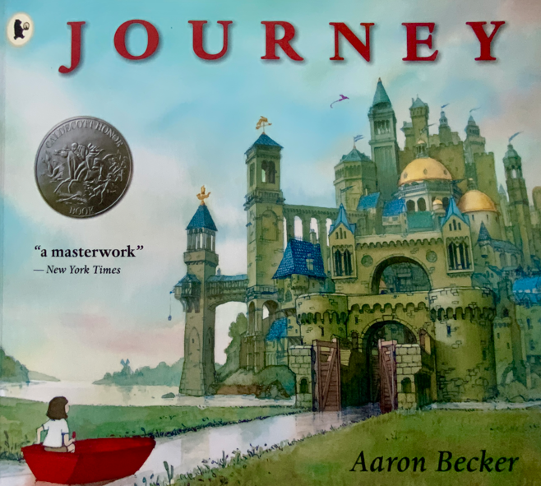
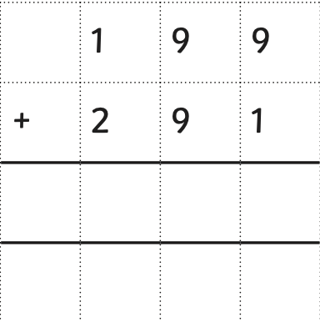
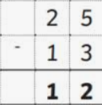
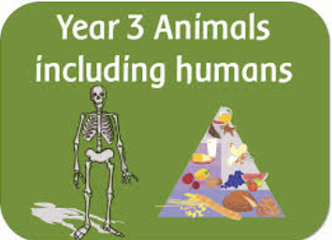
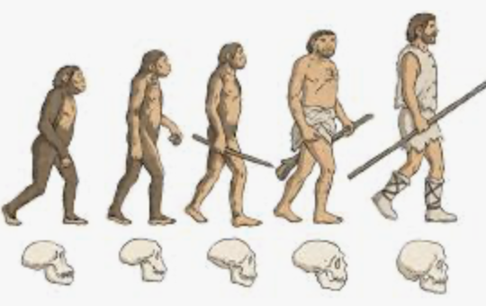
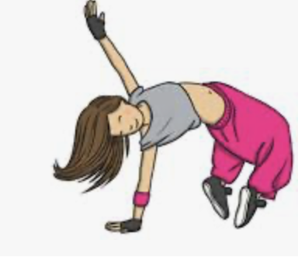
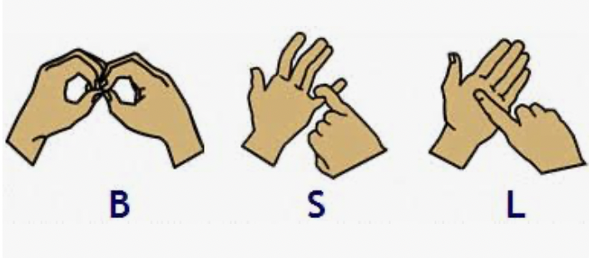



Swain House Resourced Provision
Spring 1
Our focus book this half term is:
Maths
As mathematicians we will learn to:
Add 3 digit numbers
Subtract 3 digit numbers.
Solving problems using addition and subtraction.
Idenitfy right angles in different shapes.
Measure mass, volume and capacity.
In English
We will be reading the fiction story, Journey by Aaron Becker.
We will be writing a
setting description and dialogue
Helen Keller Class | Paul Whittaker class
In BSL, we will learn:
Deaf culture at home and at school.
Deaf Community
A history of Deaf schools.
Scientists Humans including other animials.
Scientists The Human Species
PE - Football!
PE Streetdance
PSHE – Keeping Myself Safe
PSHE – Keeping Myself Safe
We will be learning how to keep safe!

