Slide 1
Reception Phonics Meeting
Swain House Primary School

Slide 2
Agenda
What is Phonics?
Why Rocket Phonics?
How will my child be taught phonics?
What will my child read?
Reading
How can I support my child at home?
Questions

Slide 3
What is Phonics?

Slide 4
What is Phonics?
Systematic Synthetic Phonics is a way of teaching children to read, write and spell. The sounds that children learn are taught in a specific, systematic order (not alphabetically) so that children can begin to build words from these sounds as early as possible.
Phonics supports children to hear, identify and link the sounds that letters make (phonemes) to what the letters look like when written down (graphemes). This helps children to recognise and read words, using knowledge of the sounds to read new or unfamiliar words.
Phonics is a cornerstone to education here at Swain House Primary School and is a lifelong skill that our children will use.

Slide 5
What is Phonics?
Here are some terms that your children will become familiar with:
Phoneme - the sound
Grapheme – how the sound is written
Digraph – Two letters which together represent one sound, e.g. ai, ee, oo.
Trigraph- Three letters which together represent one sound, e.g. igh, air, ear.
Blending – reading the individual sounds together to make a word
Segmenting – listening to a word and breaking it up into the letter sounds

Slide 6
Why Rocket Phonics?

Slide 7
Why Rocket Phonics?
https://www.youtube.com/watch?reload=9&v=sf_9Fo69wVI

Slide 8
Why Rocket Phonics?
There are lots of engaging resources such as flashcards, sound mats, and online, interactive Big Books and quizzes to develop learning further.
There is a fully matched series of decodable reading books from a variety of genres.
The clear plans and lesson structure will also ensure teaching from Reception to KS1 is consistent, and the children will already know the routine when they move to KS1.

Slide 9
How will my child be taught Phonics?

Slide 10
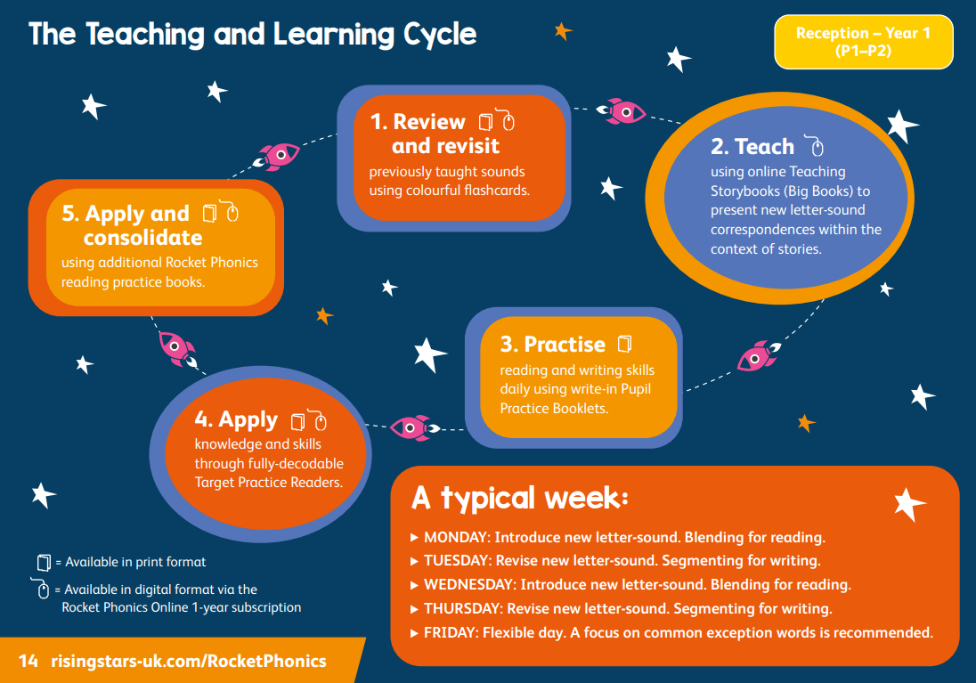
How will my child be taught Phonics?
https://www.youtube.com/watch?v=Waawaevco6E&list=PLkCyTyvoxZzuVAMhhujteytc2nVCPm6nX&index=26

Slide 11
How will my child be taught Phonics?

Slide 12
How will my child be taught Phonics?
Day 1 – Blending
Read the page of the Big Book and explore the vocabulary
Day 1 – Blending
Revisit and Review
Day 1 – Blending
Introduce the new sound, modelling the correct pronunciation

Slide 13
How will my child be taught Phonics?
Day 2
Day 2 – Segmenting
Recap taught sound and orally segment words involving taught sounds
Day 2 – Segmenting
Quickfire grapheme recall. Children air write or use mini whiteboards
Day 2 – Segmenting
Model how to form the letter and segment using dashes

Slide 14
What will my child read?

Slide 15
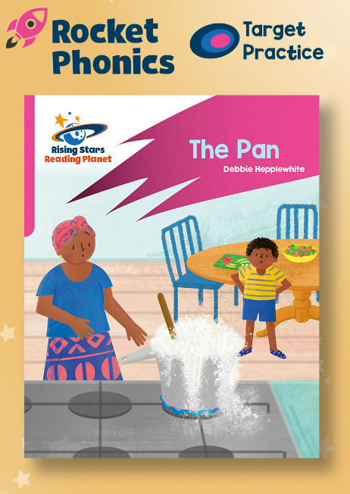
What will my child read?
Big Books – These are the books used in the Phonics sessions, exploring two pages every two days in detail around the sound being taught.
Target Practice Readers – These can be read independently as an extension, 1:1, in pairs or in small guided reading groups. These focus on smaller groups of sounds matched to your child’s phonetic knowledge.
Rocket Phonics Readers – These are the reading books your child will bring home at an appropriate level and will contain sounds your child has already learnt and is learning. These books can also be accessed online.

Slide 16
Reading

Slide 17
Reading
Whilst in Reception, your child will take part in weekly 1:1 reading sessions with a member of staff where they will read books matched to their phonetic knowledge.
Once your child has developed a number of the skills associated with reading, they will then move towards reading in groups (guided reading).
They will read books that are linked appropriately to the sounds that they have learnt and are learning.

Slide 18
How can I support my child at home?

Slide 19
Reading at home
Reading at home with an adult is part of your child’s weekly homework.
Finding any time possible to sit with your child and read in small doses will impact their progress positively.
We encourage you to read with your child at least 3 times a week.
During parent consultation evenings, your child’s progress will be discussed and pupil mentoring sheets will be shared with you.
Reading at home is an area that is tracked throughout school due to the importance we place on learning this skill.

Slide 20
Phonics at home
You can support your child to consolidate their phonics knowledge at home by playing lots of different games.
I spy games to support with hearing the initial sounds in words
Finding and searching games “ something beginning with”
Segmenting words when giving instructions e.g. c-oa-t
Drawing and writing games e.g. you write the word and they draw the picture or you draw the picture and they write the word
Treasure hunt- hiding sounds around the house to find
Grapheme spotting in the environment

Slide 21
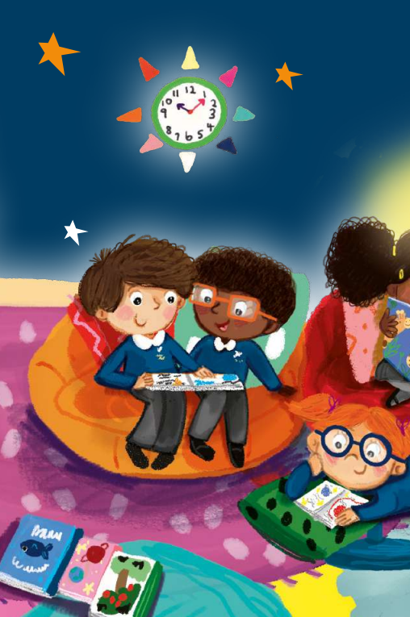
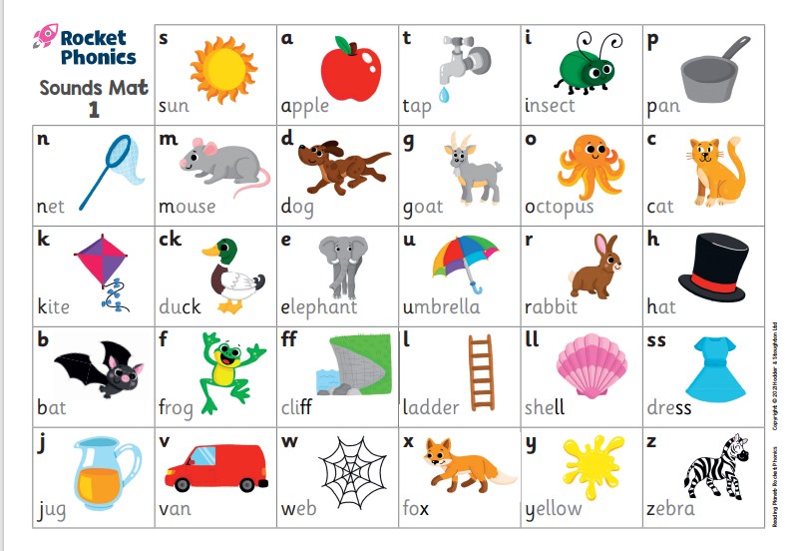
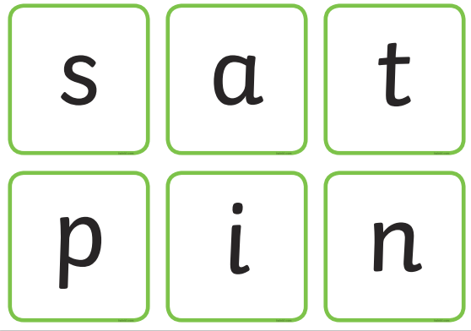
In your pack….
QR codes for:
Sound pronunciation
Teaching blending
Teaching segmenting

Slide 22
Thank you all for coming.
Any Questions?

Slide 23
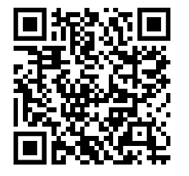
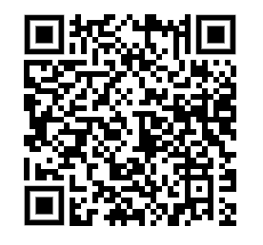
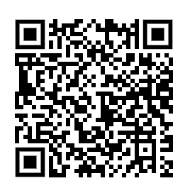
QR Codes
for sound pronunciation (pure sounds)
Video | QR Code
Correct pronunciation of sounds (pure sounds)
Teaching sequence (blending)
Teaching sequence (segmenting)

