Slide 1
Tuesday 18th October 2023
KS2 reading planet

Slide 2
Reading in KS2

Slide 3
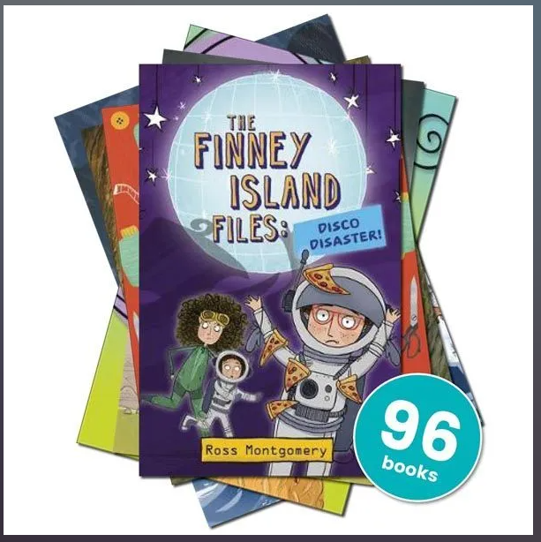
Reading Planet
We have a new set of books in school for KS2!
Will replace the Bookshelf Passport
Shelves in main corridor
Stars
Mercury
Venus
Earth
Mars
Jupiter
Saturn
Supernova
Free reader
Children have been benchmarked to the reading planet they are on. If you feel the level is too easy or too difficult for your child, please see your child’s class teacher or write a comment in the reading record book or planner.

Slide 4
Fiction

Slide 5
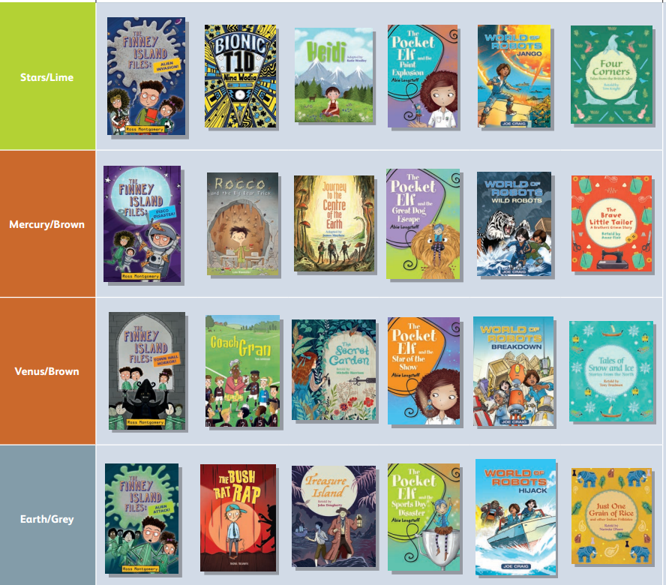

Slide 6
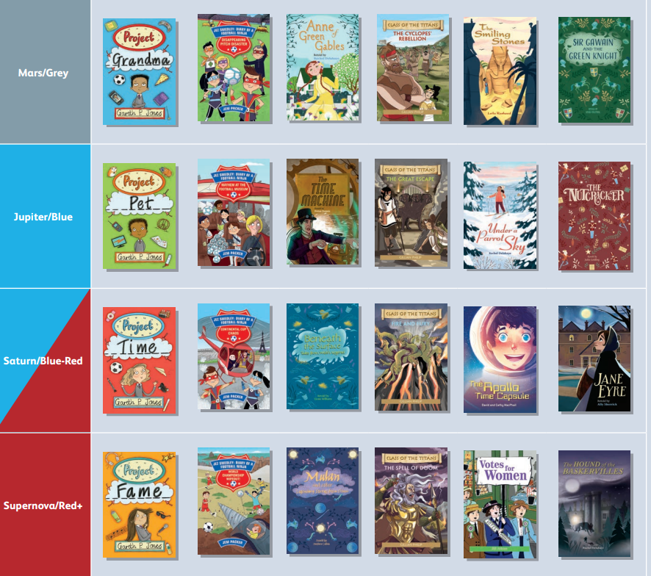

Slide 7
Non-Fiction

Slide 8
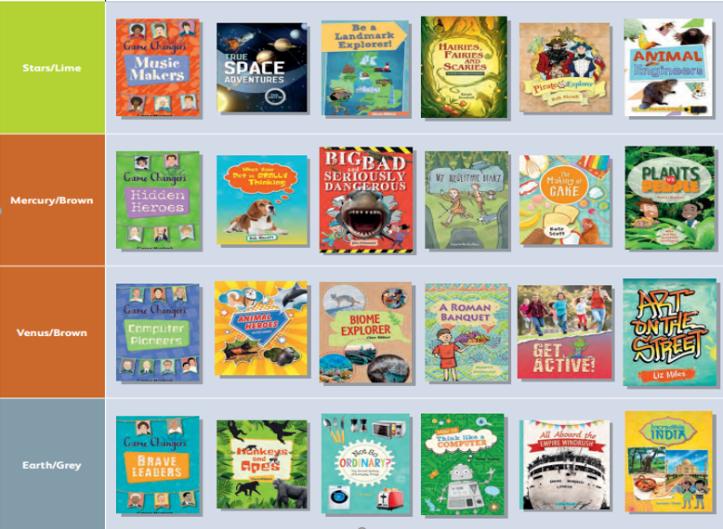

Slide 9
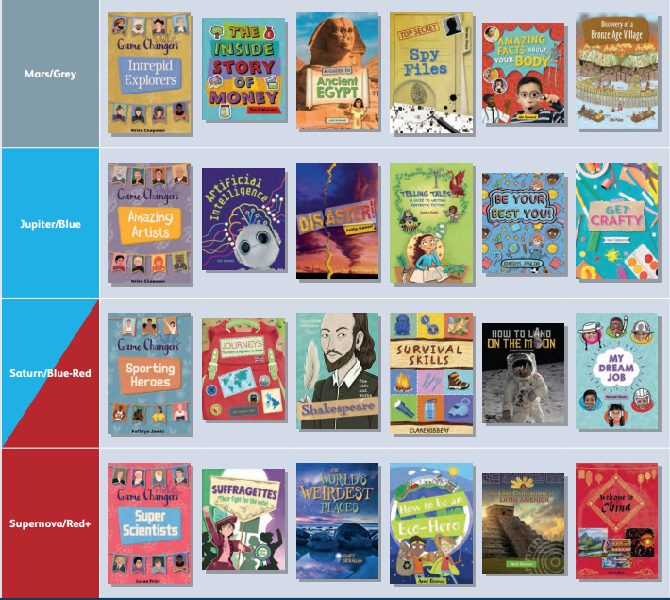

Slide 10
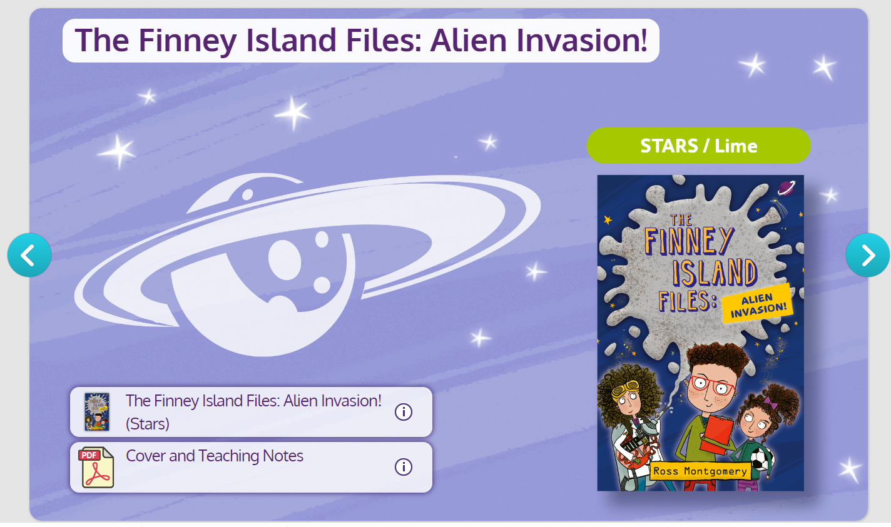

Slide 11
Logins
Children’s username is the first 3 letters of first name and full last name e.g. Claire Broomfield – clabroomfield
Passwords
Anne Fine class – cat
Roald Dahl – ape
JK Rowling – bat
Jacqueline Wilson – cow
Elgar – dog
Mozart – owl
Beethoven – fox
Vivaldi – rat

Slide 12
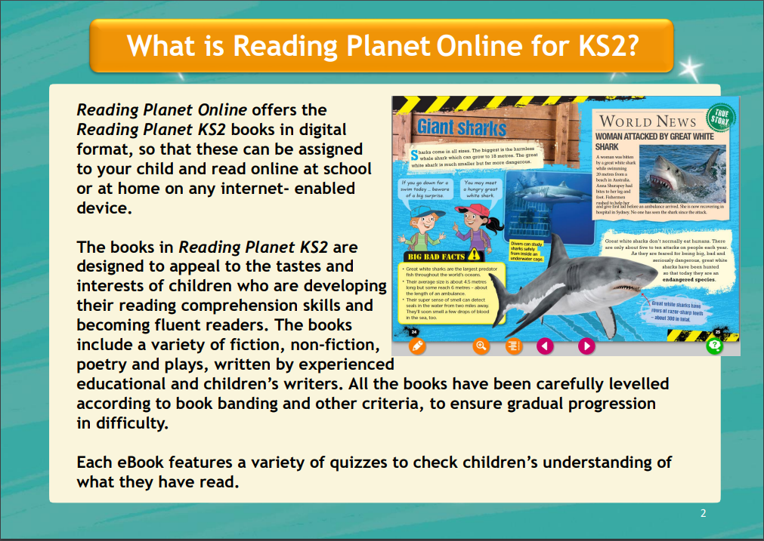

Slide 19
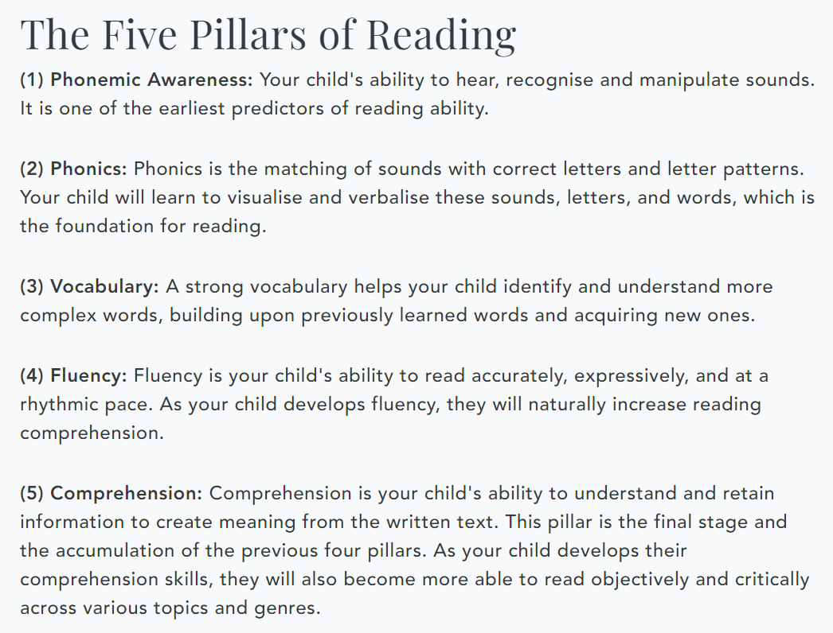
Reading for pleasure

Slide 21
Swain house reading expectations
Bring reading folder and record / planner into school each day
Read 3 times weekly at home
Please write a comment of which pages read and how they did with the reading

Slide 22
Any questions?

