Slide 1


Science
Scientists and Inventors
Year One
Science | Year 5 | Scientists and Inventors | David Attenborough | Lesson 1

Slide 2
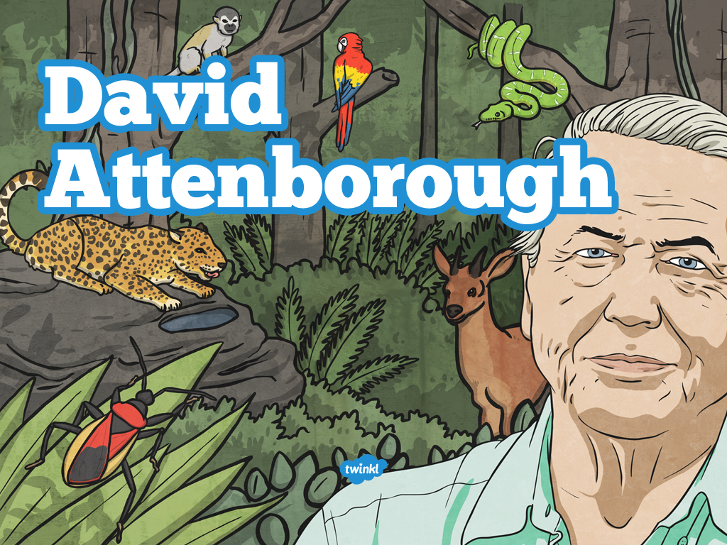

Slide 3
Aim
I can describe the life and work of David Attenborough.
Success Criteria
I can answer questions about David Attenborough’s life.
I can identify how David Attenborough describes animals in his documentaries.
I can create my own documentary inspired by David Attenborough’s work.

Slide 4
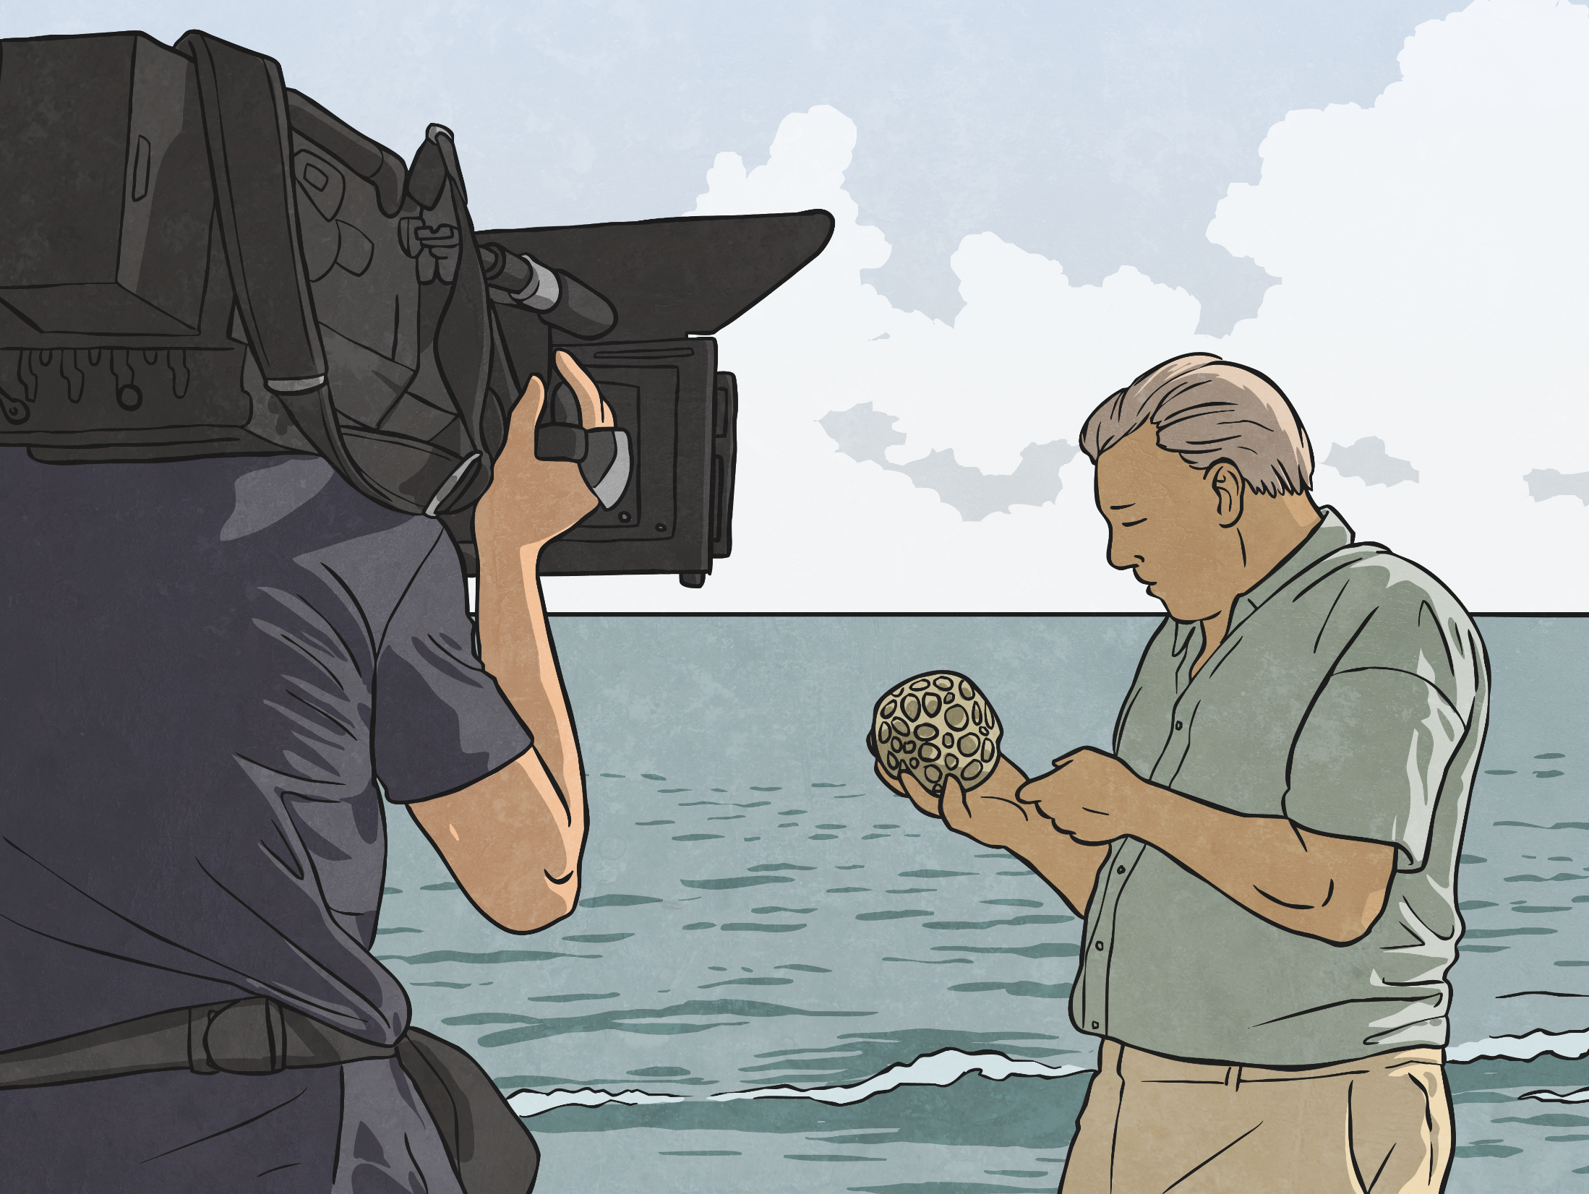
Life on Film
David Attenborough is a wildlife film-maker and naturalist. This means he is a scientist who studies animals and their behaviour.
He has written and presented many popular documentaries about animals and their lives.
Attenborough has been a presence on our television screens for over 60 years and his programmes have brought him international recognition.

Slide 5

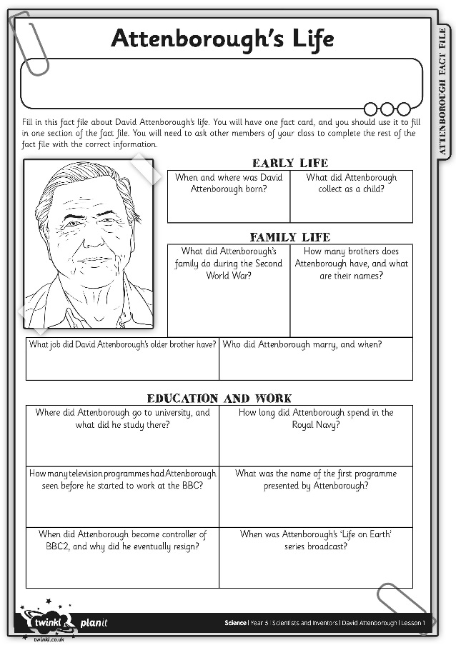
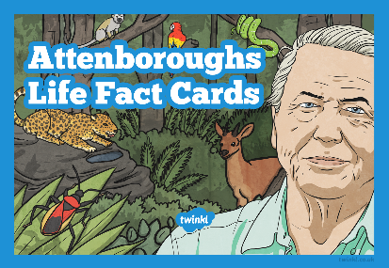
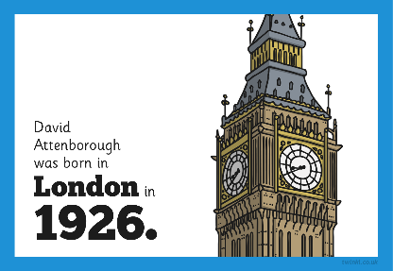
Attenborough's Life
Play this game to find out more about David Attenborough's life and work.
Your Attenborough's Life Activity Sheet has 12 questions about David Attenborough's life up to the broadcast of his first famous documentary. You need to find the answers to these questions.
You also have an answer card. Use this card to answer one of the questions.
Other members of your class have different answer cards. Move around the classroom and ask other children for their answers until you can solve all of the questions on your Activity Sheet.

Slide 6
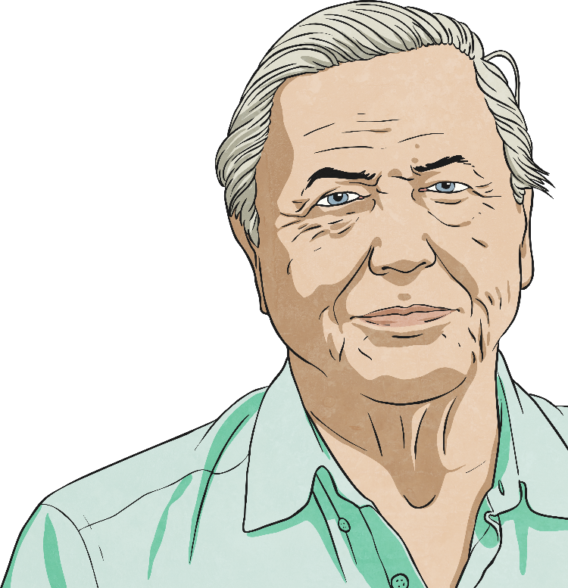
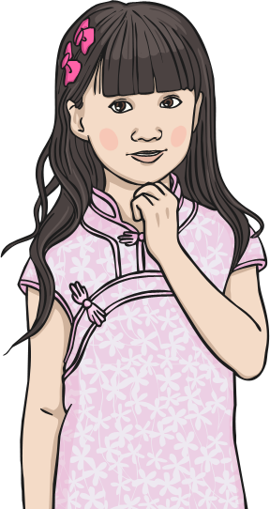
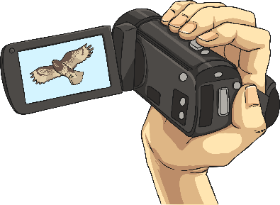
Attenborough's Life
Did you manage to find all 12 answers?
After Attenborough's series
'Life on Earth' was broadcast
in 1979, he went on to write
and make many other series.
These include over 250
episodes of 'Wildlife on One',
'The Natural World',
'Life in the Freezer' and
Planet Earth'.
He is still working on new documentaries now.

Slide 7

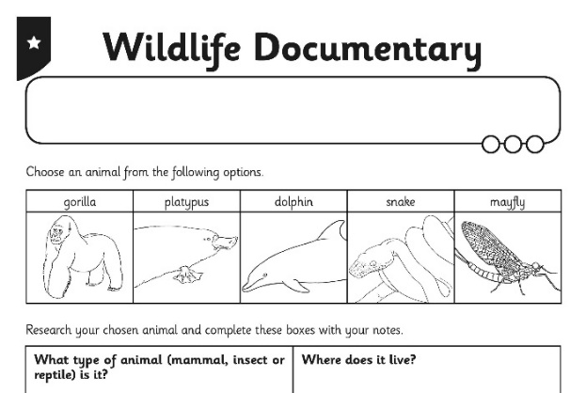
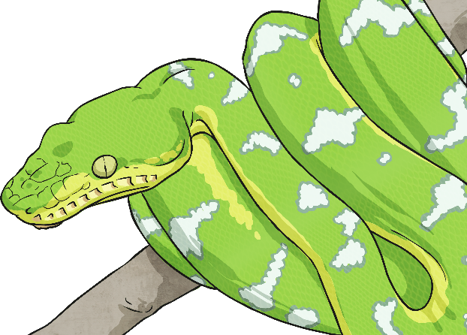
Wildlife Documentary
You are going
to be a wildlife film-maker like David Attenborough!
Choose an animal from the options on the Wildlife Documentary Activity Sheet and use the Internet or books to find out
about it. Think about what type of
animal it is, where it lives and its
behaviour. Use your Activity Sheet to
gather and organise the facts you need.

Slide 8

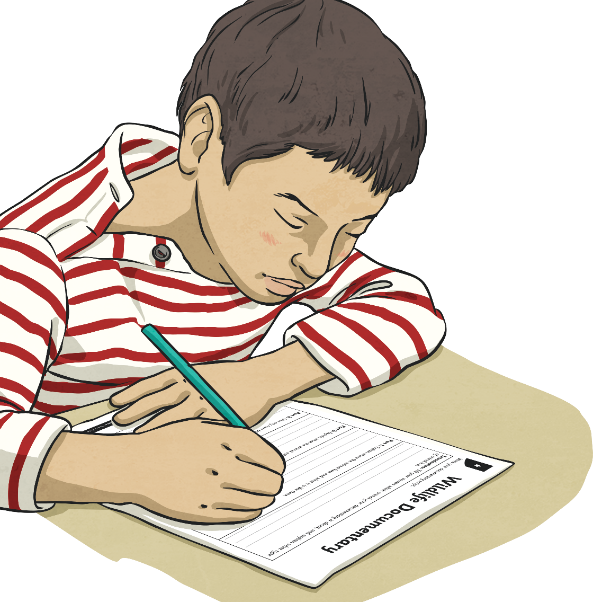
Wildlife Documentary
Once you have collected your information, use it to write a short
script on your Activity Sheet.
You will perform your documentary
to an audience.
You may be able to perform it alongside a clip of your
chosen animal from one
of Attenborough's films.

Slide 9
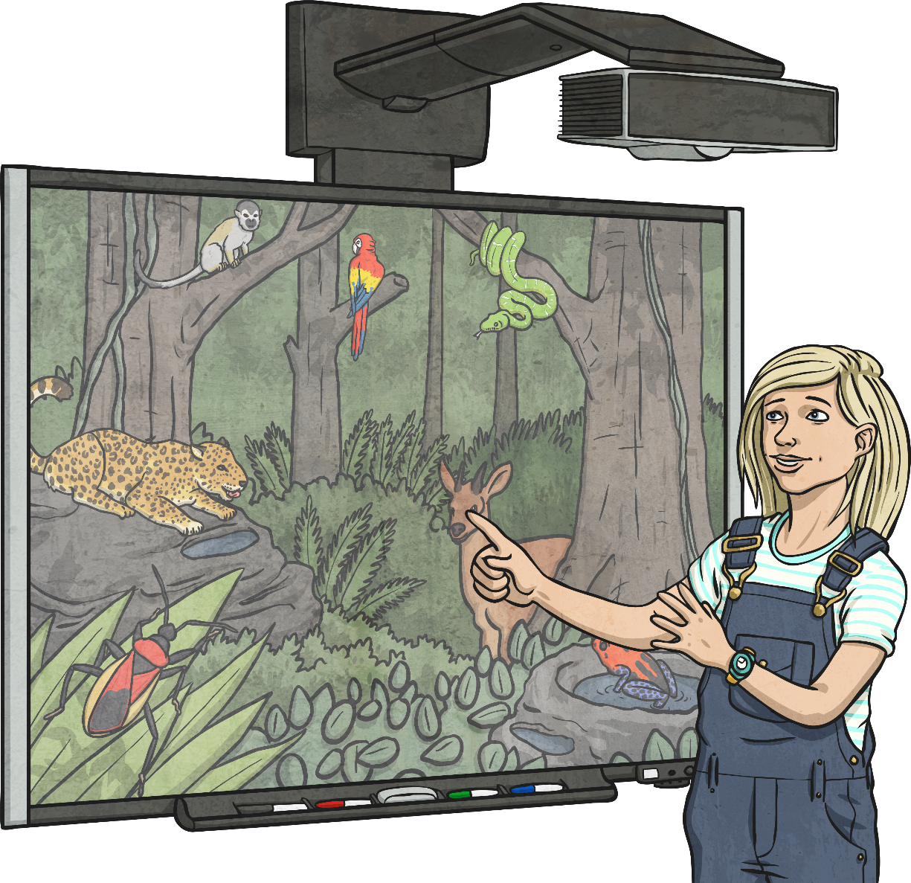
Performance
Now that you have written your script, it is time to present your documentary!
Try to act as confidently and speak as clearly as David Attenborough.

Slide 10

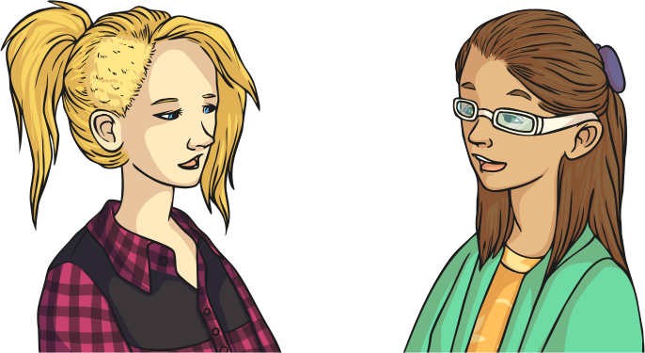
Evaluation
Are you pleased with how you performed your documentary?
What went well?
What would you have liked to improve?
Talk to your partner about your thoughts.

Slide 11

Aim
I can describe the life and work of David Attenborough.
Success Criteria
I can answer questions about David Attenborough’s life.
I can identify how David Attenborough describes animals in his documentaries.
I can create my own documentary inspired by David Attenborough’s work.

