Slide 1

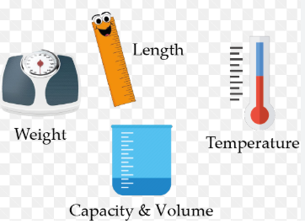
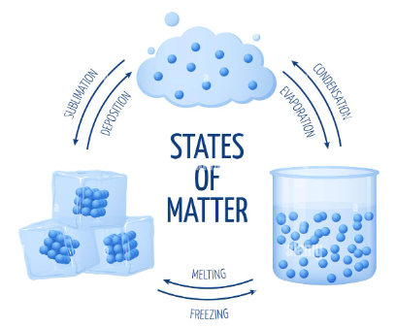
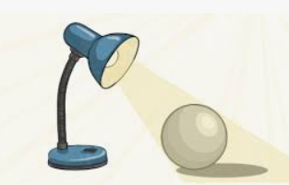
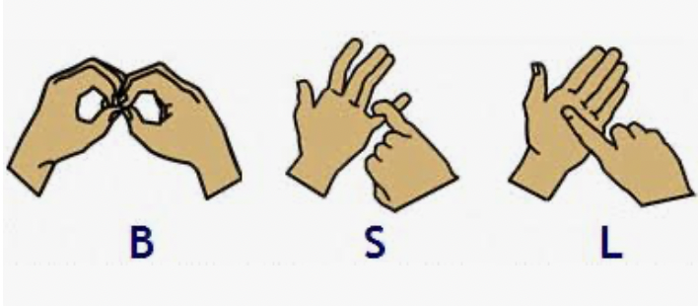
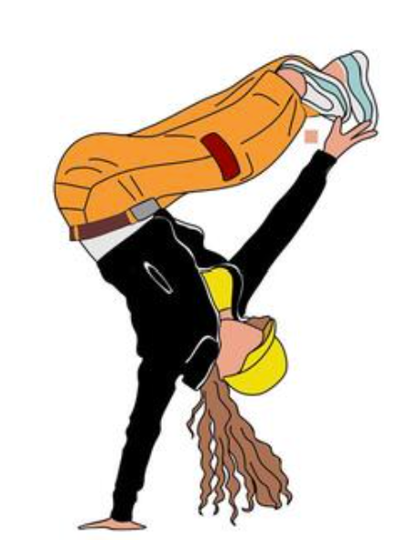
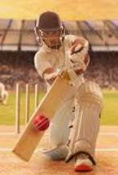

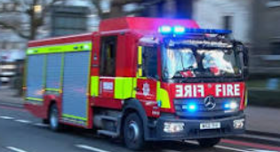
Swain House Resourced Provision
Summer 1
Our focus book this half term is:
Maths
As mathematicians
we will learn about:
Weight and Mass
Temperature, Capacity
and Length
Data/Tally Charts
X4 and x8 focus
In English
We will be reading the fiction story,
The Bear and the Piano by David Litchfield.
We will develop our sentence writing through questions, captions, instructions, postcards/poster work and opinions, while exploring themes of community, friendship and the environment.
Helen Keller Class | Paul Whittaker class
In BSL, we will learn about:
Family and Family trees
Scientists Changing States
Scientists LIGHT!
PE Year 4 – Street Dance Year 5/6 - Netball
PE – Cricket (Y2) Street Dance (Y3&4)
PSHE Growing up and changing. Making safer choices.
PSHE Growing up and changing
Fire Service visit 10am
28/4/26

